Slide 1
IMMERSE Consortium meeting
22.04.2021

Slide 2
Development Work of TherapyDesigner
System currently under development
Lots of tasks → early requirements from IMMERSE allow for better prioritization

Slide 3
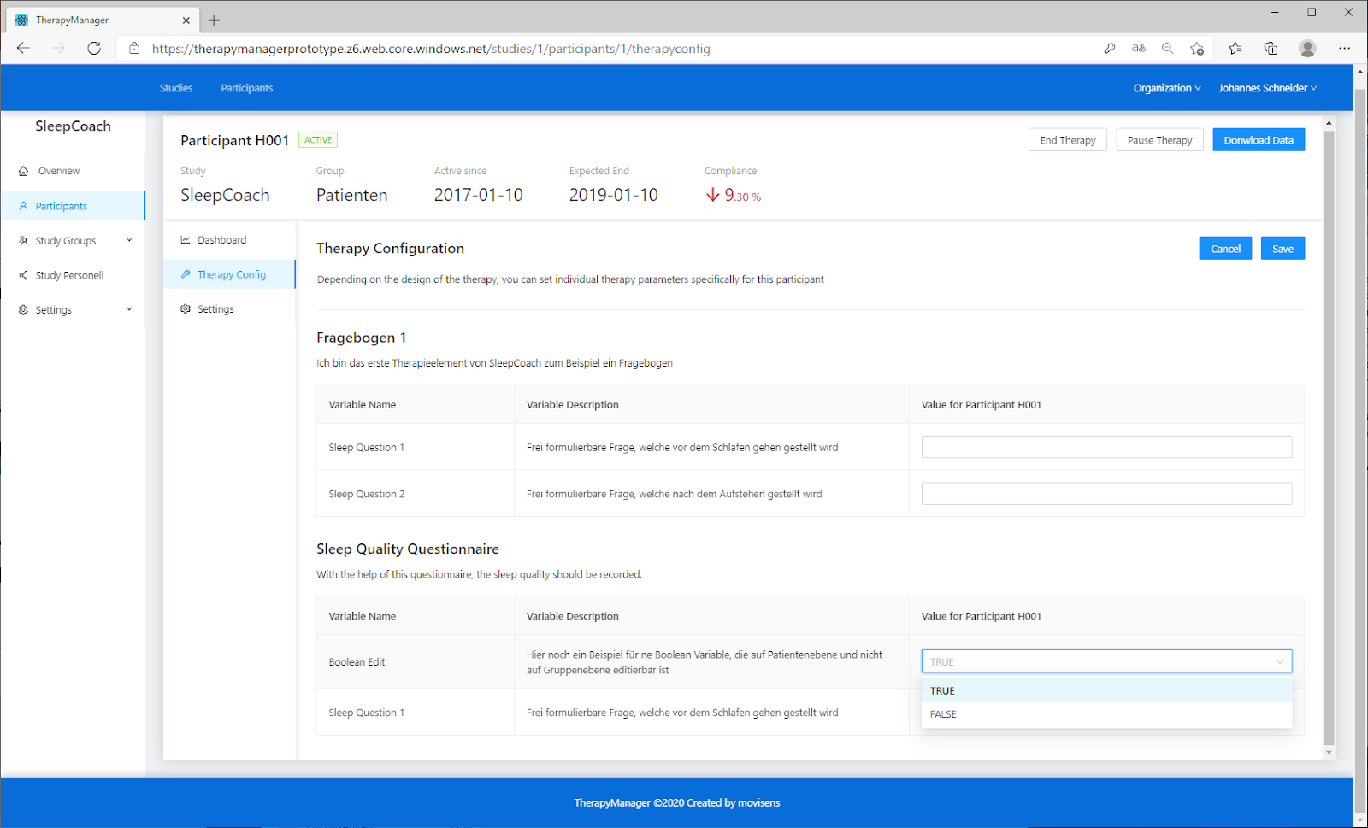
Current TherapyManager
Notes:
Allows therapist to view data from patient
Allows study personnel to manage parts of the therapy

Slide 4
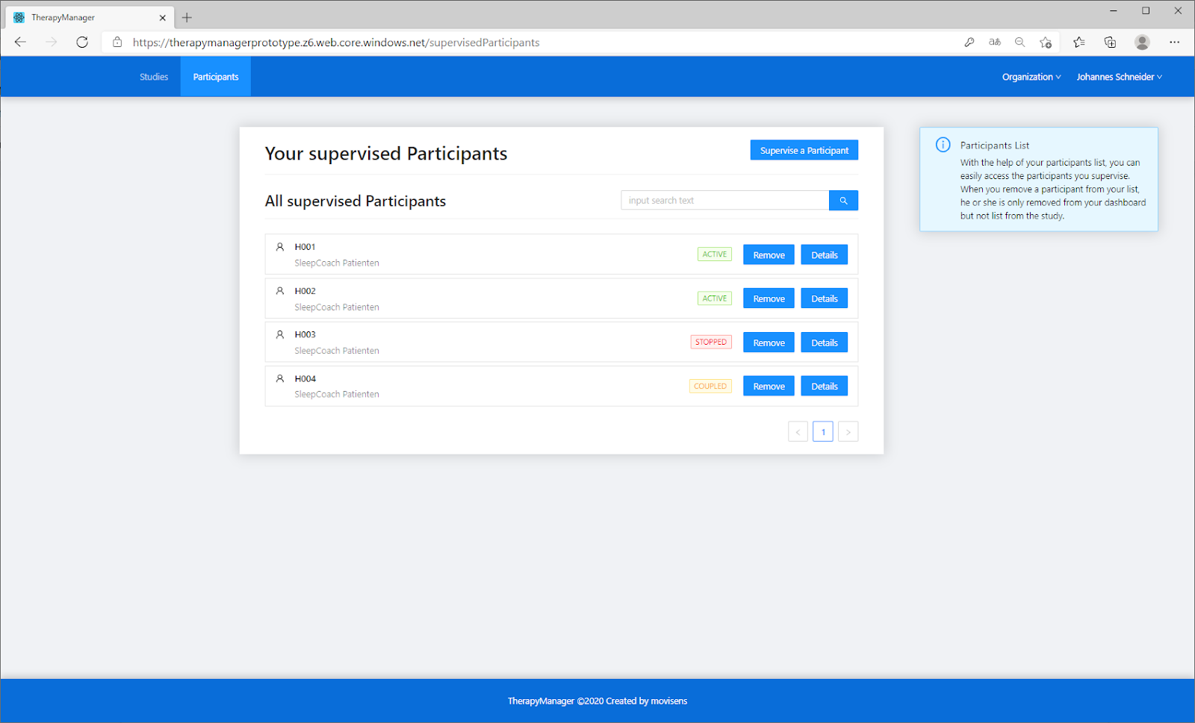
Current TherapyManager
Notes:
Allows therapist to view data from patient
Allows study personnel to manage parts of the therapy

Slide 5
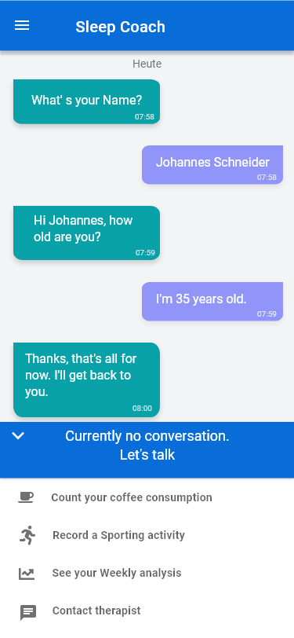
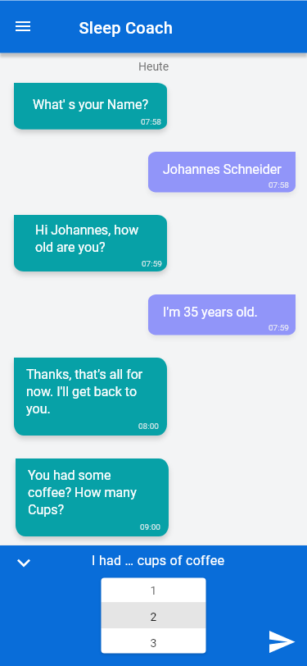
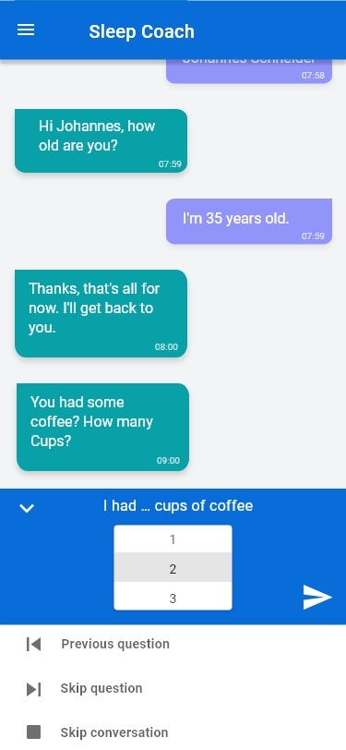
Current TherapyDesigner App

Slide 6
Plans and Procedure for future regulatory relevant activities
Overview of plan till beginning of evaluation
Input of consortium is necessary
Procedure to involve relevant parts of consortium in each activity

Slide 7
Plan till M6

Slide 8
Plan M6 till M18

Slide 9
Results: Involvement Procedure
Each activity requires input from different experts/roles
Description of roles/experts will be sent to Work package leaders -> Return list of persons matching roles description
For each activity:
movisens provides upfront information about goal/task of activity as well as a template for notes
After 2 weeks movisens will conduct a workshop to discuss/conduct the activity (Duration and amount of workshop varies depending on the activity)
Depending on activity movisens will collect notes beforehand to create a consolidated document as the base for the discussion
movisens creates a final document and shares it with all participants for review

Slide 10
Thank You! www.movisens.com

