Slide 1
WP2 Prototype Development
Simon Krause WP lead
movisens GmbH
EC Evaluation December 1st
This project has received funding from the European Union’s Horizon 2020 research and innovation Programme under grant agreement 945263 (IMMERSE)

Slide 2
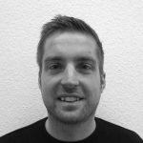
WP2 – Team
Dr. Jörg Ottenbacher Regulatory Affairs
Dr. Jürgen Stumpp
System-Architecture
Robert Zetzsche
App-Development
Dr. Johannes Schneider
Web-Development
Simon Krause
Backend-Development
This project has received funding from the European Union’s Horizon 2020 research and innovation Programme under grant agreement 945263 (IMMERSE)

Slide 3
WP2 – Objectives
Development of prototype according to MDR requirements
Deployment and Maintenance of prototype during the study
This project has received funding from the European Union’s Horizon 2020 research and innovation Programme under grant agreement 945263 (IMMERSE)

Slide 4
WP2 – Development Process
This project has received funding from the European Union’s Horizon 2020 research and innovation Programme under grant agreement 945263 (IMMERSE)

Slide 5
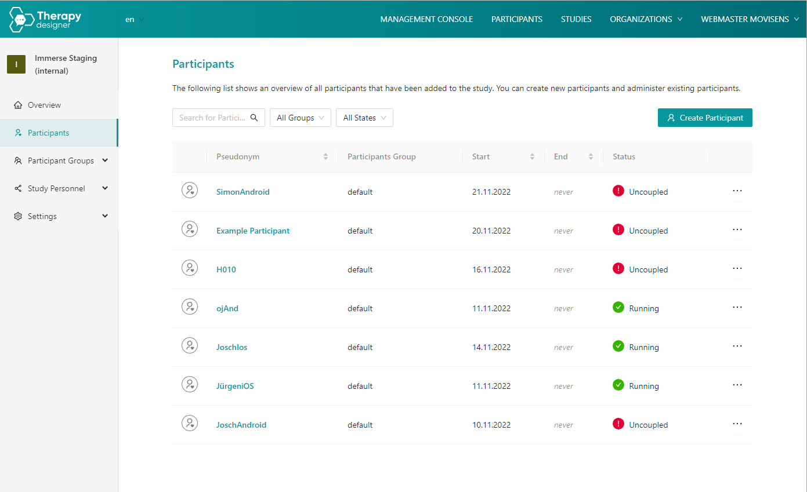
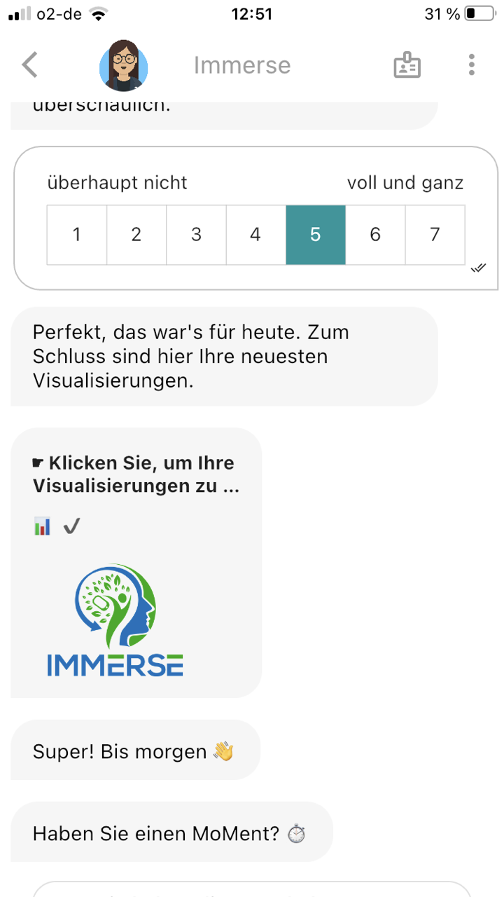
WP2 – Prototype: Overview
MoMent-Dashboard
MoMent-App
Clinician
Service user
This project has received funding from the European Union’s Horizon 2020 research and innovation Programme under grant agreement 945263 (IMMERSE)

Slide 6
WP2 – Prototype: MoMent-Dashboard (Configuration)
This project has received funding from the European Union’s Horizon 2020 research and innovation Programme under grant agreement 945263 (IMMERSE)

Slide 7
WP2 – Prototype: MoMent-App
Conversational User Interface
This project has received funding from the European Union’s Horizon 2020 research and innovation Programme under grant agreement 945263 (IMMERSE)

Slide 8
WP2 – Prototype: MoMent-App
This project has received funding from the European Union’s Horizon 2020 research and innovation Programme under grant agreement 945263 (IMMERSE)

Slide 9
WP2 – Prototype: MoMent-Dashboard (Feedback)
This project has received funding from the European Union’s Horizon 2020 research and innovation Programme under grant agreement 945263 (IMMERSE)

Slide 10
WP2 – Testing: Usability
App-Usability
Feedback Usability
Study Management Usability
Configuration Usability
This project has received funding from the European Union’s Horizon 2020 research and innovation Programme under grant agreement 945263 (IMMERSE)

Slide 11
WP2 – Testing: System tests
Stakeholder Requirements:
DMMH-001
DMMH-002
DMMH-003
.
.
.
DMMH-072
Stakeholder Requirements:
DMMH-001 ✔
DMMH-002 ✔
DMMH-003 ✔
.
.
.
DMMH-072 ✔
System tests
This project has received funding from the European Union’s Horizon 2020 research and innovation Programme under grant agreement 945263 (IMMERSE)

Slide 12
WP2 – Deliverables & Milestones
Milestone / deliverable | Title | Original deadline | Status
D2.1 | Prototype for Study | Month 18 / 30.09.2022 | ✅ / finished
MS2 | Requirements engineering done | Month 6 / 30.09.2021 | ✅ / finished
MS4 | Preliminary Hazard Analysis (PHA) | Month 12 / 31.03.2022 | ✅ / finished
MS8 | Interface to Big Data System | Month 18 / 30.09.2022 | ✅ / ongoing
D2.2 | Final prototype of DMMH including corrections | Month 48 / 31.03.2025 | ✅ / started
This project has received funding from the European Union’s Horizon 2020 research and innovation Programme under grant agreement 945263 (IMMERSE)

Slide 13
WP2 – Challenges, delays, and solutions
Delay of requirements
→ Iterative development and restructuring of implementation work
Delay of Interface to Big Data System → Internal Database implemented to meet interface criteria
Systematic processing of Feedback with consortium → Development of Feedback process
This project has received funding from the European Union’s Horizon 2020 research and innovation Programme under grant agreement 945263 (IMMERSE)

Slide 14
WP2 – Dissemination
3 Company Newsletters
Twitter-Communication
Presentation of Usability Test Process as part of World Usability Day event
This project has received funding from the European Union’s Horizon 2020 research and innovation Programme under grant agreement 945263 (IMMERSE)

Slide 15
WP2 – Next steps
Establish process/system for structured support
Continous development of final prototype based on feedback
Operation, maintenance and observation of prototype
This project has received funding from the European Union’s Horizon 2020 research and innovation Programme under grant agreement 945263 (IMMERSE)

