Slide 1
WP3 Data Management, Data Security and Interoperability
Thomas Ganslandt
Friedrich-Alexander-University Erlangen-Nuremberg (previously: Mannheim Medical School at University of Heidelberg)
EC Evaluation December 1st
This project has received funding from the European Union’s Horizon 2020 research and innovation Programme under grant agreement 945263 (IMMERSE)

Slide 2
WP3 - Staff
Thomas Ganslandt
Physician (MD) Medical Informatics
PI UHEI/UKER
Geun-Hyun Kim
Physics (B.A.)
Psychology (Dipl.)
Data Science & Usability
Tariq Elahi
Computer Scientist (PhD)
Privacy & IT Security
30 PM UHEI => UKER
2.4PM UEDIN
This project has received funding from the European Union’s Horizon 2020 research and innovation Programme under grant agreement 945263 (IMMERSE)

Slide 3
WP3 - Objectives
DMMH Intervention
Treating physicians
Service users
1. Ensure the acquisition, processing and deposition of data according to the FAIR guiding principles by means of a comprehensive data management plan
Trial Data Capture
2. Define interoperable data structures and interfaces for the capture and transfer of data in the consortium based on established standards and terminologies
Researchers (unblinded)
Research Data Management
Researchers (Blinded)
3. Implement and operate central IT components (ID- and Consent Management, Electronic Data Capture platform, Research database) conforming to security & data protection requirements
This project has received funding from the European Union’s Horizon 2020 research and innovation Programme under grant agreement 945263 (IMMERSE)

Slide 4
Task 3.1: FAIR Data Management (1)
Development of a Data Management Plan (DMP)
Inventory of data sets, data items and potential artifacts
Suitable metadata annotations & terminologies
Data Sharing & integration of Data Governance Policy, suitable license
Patient data protection & security aspects, including threat analysis
Maintenance of the DMP throughout the project
Deposition & long-term archiving of datasets & artifacts
Interactions with other WPs:
WP 2, 4, 7: requirements gathering regarding datasets & artifacts
WP 6: data sharing aspects in the informed consent, data governance policy
WP 5, 8: licensing & dissemination
This project has received funding from the European Union’s Horizon 2020 research and innovation Programme under grant agreement 945263 (IMMERSE)

Slide 5
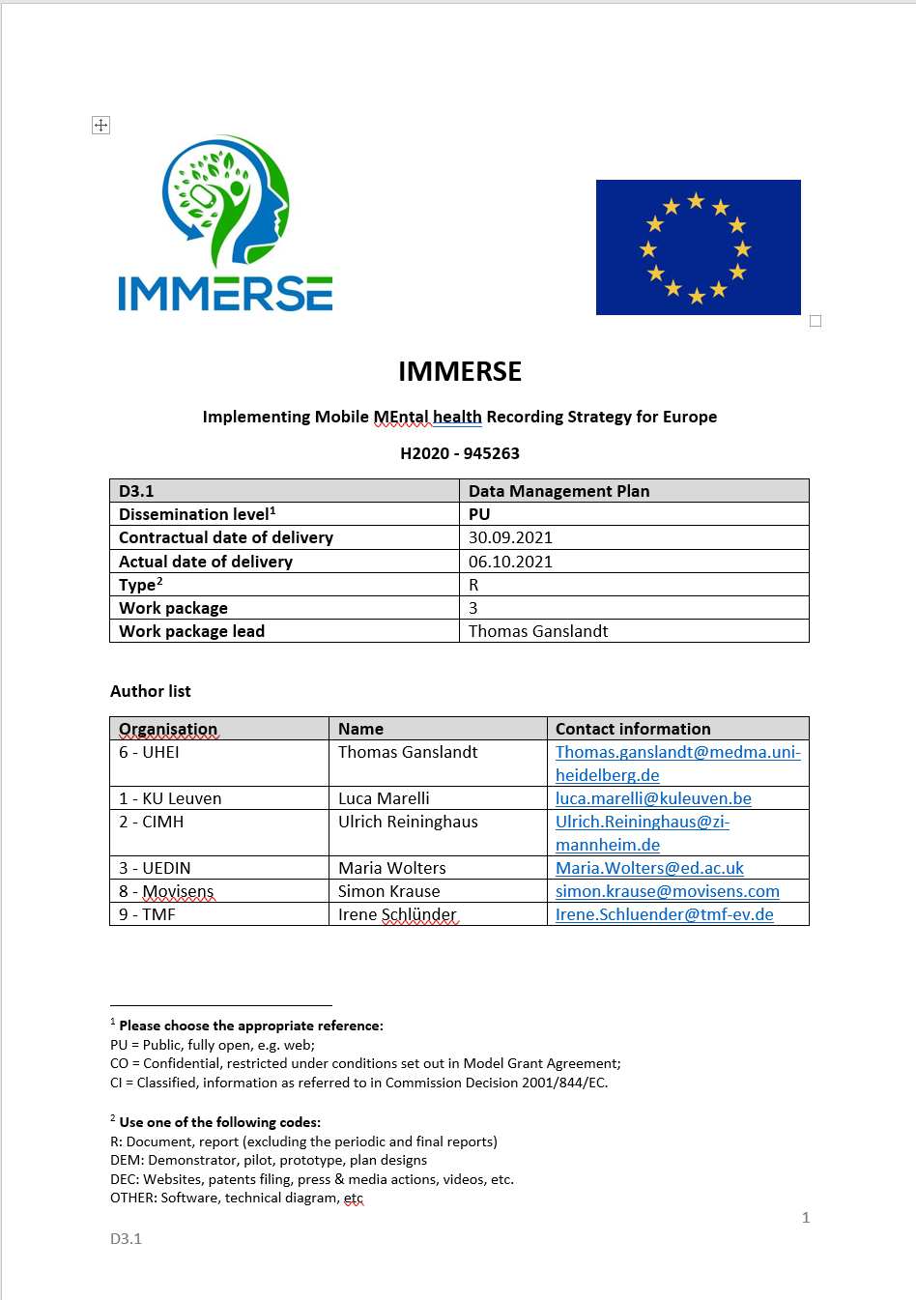
Task 3.1: FAIR Data Management (2)
Status after first period
first release of DMP was delivered on time, covering phase I datasets
data management aspects were contributed to the WP2 requirements specification document & WP7 clinical investigation plan
second release of DMP in preparation
addition of DataCite metadata schema for annotation of datasets & artifacts
addition of phase II data capture aspects
extension of inventory with phase II datasets
Data Summary
Purpose of data collection
Data types and formats
Re-use of existing data
Data utility
FAIR Data
Making data findable and accessible
Making data interoperable & reusable
Increase data re-use
Allocation of resources
Data security
Ethical aspects
Conclusions
References
Appendices
Inventory of datasets & artifacts
This project has received funding from the European Union’s Horizon 2020 research and innovation Programme under grant agreement 945263 (IMMERSE)

Slide 6
Task 3.1: FAIR Data Management (3)
Long-term archiving
FAU DataCloud: storage of internally used datasets, assignment of PIDs for internal use
FAU RADAR: storage of publicly available datasets, assignment of DOIs, registration in catalog of FAU library
encrypted archiving of datasets with person-related datasets
Access to project datasets
contribution to data governance process (WP6)
submission of data use requests through coordinated process based on Open Science Framework
structured capture of project description, requested datasets & data items
decision by data governance board
This project has received funding from the European Union’s Horizon 2020 research and innovation Programme under grant agreement 945263 (IMMERSE)

Slide 7
Task 3.2: Interoperable Data Structures (1)
Goal: Interoperability with international clinical/scientific data platforms
by use of internationally adopted data structures & terminologies
e.g. German Medical Informatics Initiative
Development of an Implementation guide
based on the data inventory
specification of data structures based on HL7 FHIR standard
semantic annotation with terminologies like LOINC & SNOMED CT
Design of an architecture for the central IT platform
Maintenance of the Implementation guide throughout the project
Interactions with other WPs:
WP 2: Data source structures & interfaces for Movisens platform
WP 4: requirements regarding data provision for analysis
WP 7: requirements for ESM/eCRF data elements
This project has received funding from the European Union’s Horizon 2020 research and innovation Programme under grant agreement 945263 (IMMERSE)

Slide 8
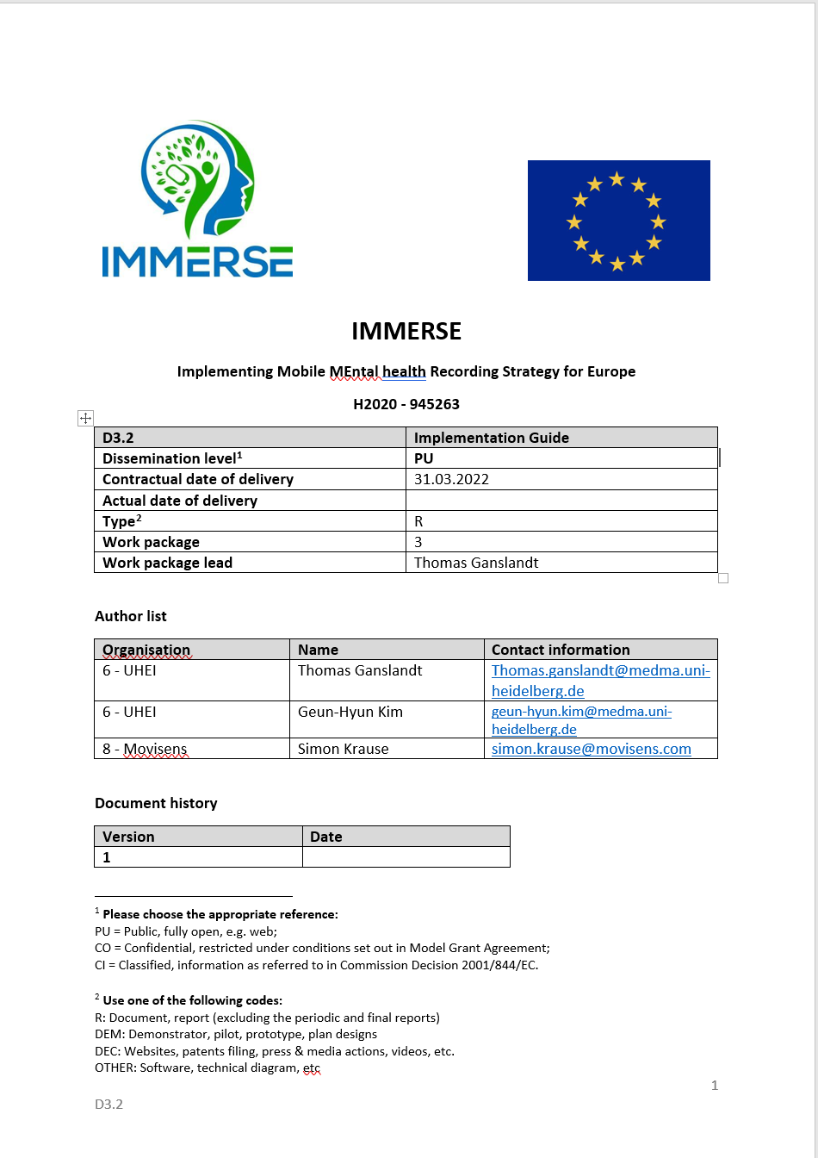
Task 3.2: Interoperable Data Structures (2)
Status after first period
Implementation Guide deliverable released on time
covers architecture, data structures for questionnaires (from eCRF, movisensXS & MoMent) & sensor data
Ongoing work
started version 2 adressing changes to architecture during implementation, semantic annotation of questionnaires
added coding of items & responses in eCRFs
after completion of eCRFs, semantic annotation of questionnaire items and valuesets is currently ongoing
Approach for the Implementation Guide
Architecture
Data Elements for Study & Participants
IMMERSE_ResearchSubject
IMMERSE_Patient
IMMERSE_Organization
Data Elements for Questionnaires & Responses
IMMERSE_Questionnaire
IMMERSE_QuestionnaireResponse
IMMERSE_QuestionnaireResponseObservation
Data Elements for Mobile Sensor Data
IMMERSE_GeolocationObservation
IMMERSE_ActivityObservation
IMMERSE_StepsObservation
IMMERSE_DeviceOnOffObservation
IMMERSE_DisplayOnOffObservation
IMMERSE_AppUsageObservation
IMMERSE_NotificationObservation
This project has received funding from the European Union’s Horizon 2020 research and innovation Programme under grant agreement 945263 (IMMERSE)

Slide 9
DMMH Intervention
MoMent Data Entry & Schedule Configuration
1
2
MoMent Data & Schedule Configuration
Reports & Visualizations
Moment Dashboard
MoMent Data &
Visualizations
DMMH Backend
3
MoMent App
A
A
Treating physicians
MoMent Items & Schedule Configuration
Schedule & Therapist Configuration
MoMent Items & Visualizations
Monitoring & Feedback
Service users
User Administration
Trial Data Capture
Study & User Administration
ESM & Sensor Data Capture
4
DMMH Data (JSON)
movisensXS
Sensor Data (JSON)
B
C
Researchers (unblinded)
Physician eCRF Data entry
Site Enrollment Logs
Identifying data
Pseudonyms
Study-IDs
Research Data Management
8
Data extracts (FHIR, CSV)
6
5
Implementation
DMMH Analysis & Compute Area
DMMH Research Database
Maganamed eCRF
F
D
Patient eCRF Data entry
Researchers (Blinded)
Analyses
E
eCRF Data (CSV)
Re-Pseudonymization
7
ID Management
Long-term Archive
Technical Interfaces
Clinical Care Data
Research Data
Identifying & Pseudonym Data
1
Components
Interfaces
User Interaction
A

Slide 10
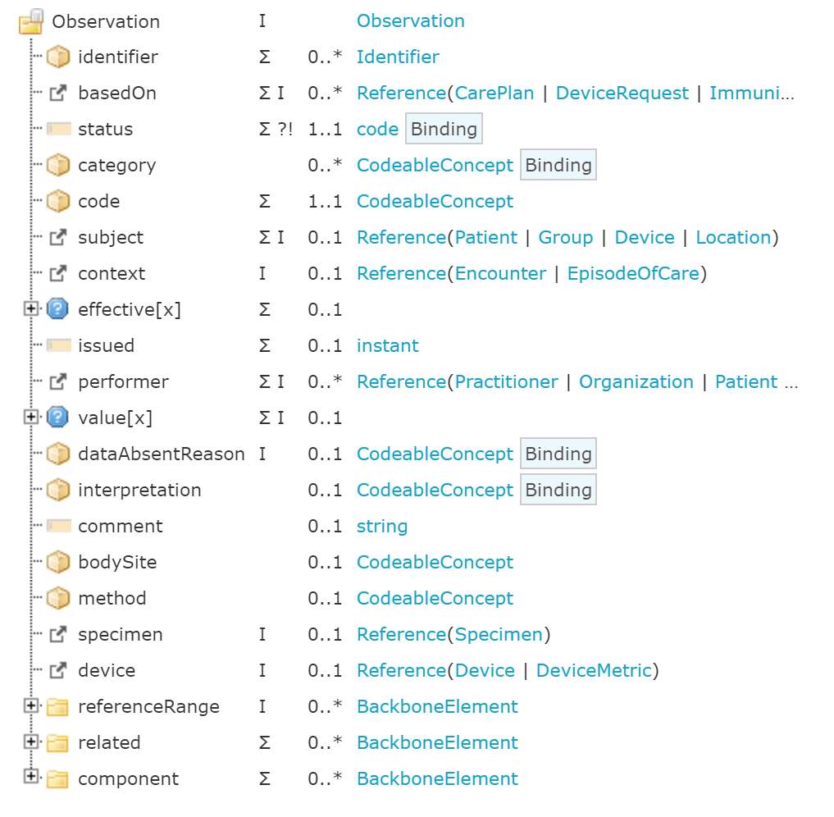
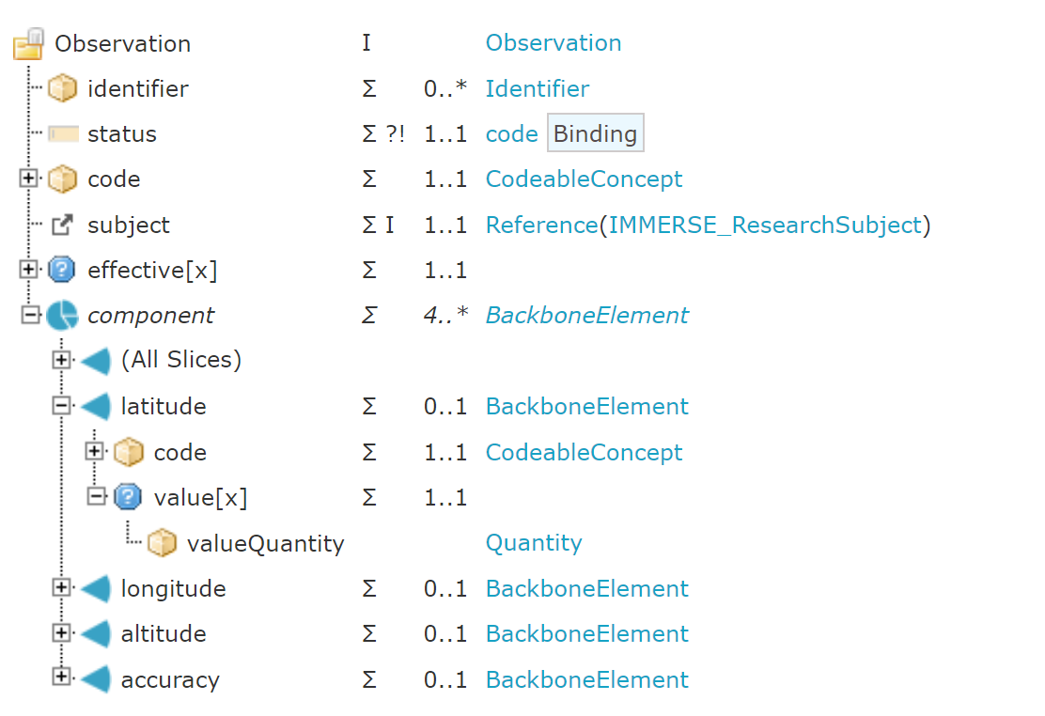
Task 3.2: Interoperable Data Structures (4)
Specification & dissemination of IMMERSE FHIR Profiles
based on basic FHIR resources: https://www.hl7.org/fhir/resourcelist.html
adapted to IMMERSE needs
resulting profiles disseminated on Simplifier platform: https://simplifier.net/IMMERSE-EU
Generic FHIR
Observation
Resource
IMMERSE Geolocation Profile
This project has received funding from the European Union’s Horizon 2020 research and innovation Programme under grant agreement 945263 (IMMERSE)

Slide 11
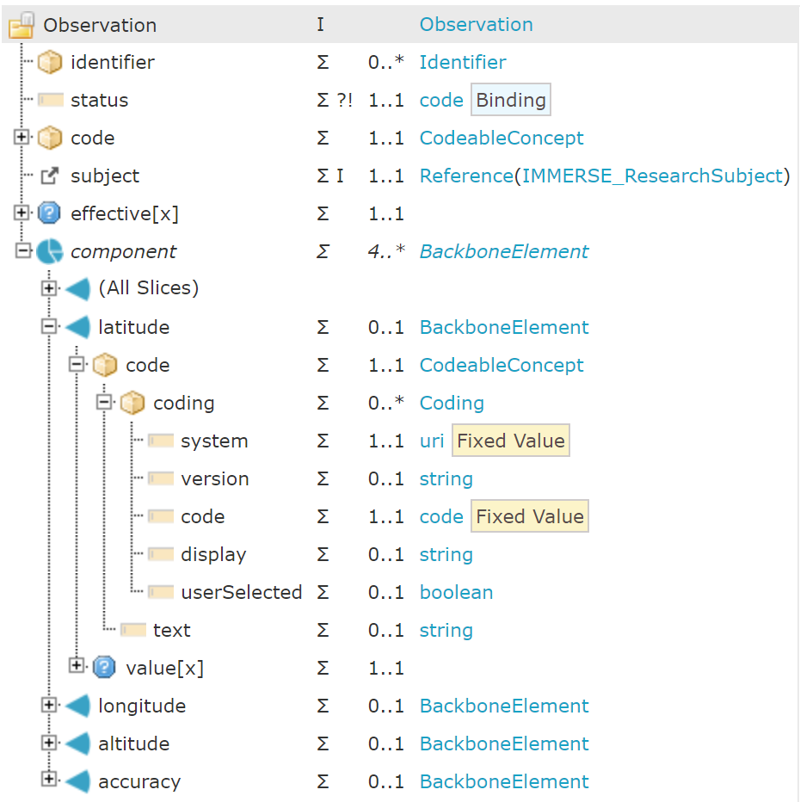
Task 3.2: Interoperable Data Structures (5)
unique identifier
semantic code for data element
attribute for latitude of geolocation
coding system: loinc
code: 91588-4 (Latitude event)
value of attribute
other attributes
This project has received funding from the European Union’s Horizon 2020 research and innovation Programme under grant agreement 945263 (IMMERSE)

Slide 12
Task 3.3: Implementation & Operation of Central IT (1)
Scope:
Integration of Data Capture platforms, ID-Management, Research Database
Interfaces for data import
Movisens platform (movisensXS, MoMent), Maganamed eCRF
Interfaces for data use
data provision for analysis, including execution (optional) of analysis code
data deposition to longterm archiving
Provision/Maintenance of platform in 3 releases throughout project
Interactions with other WPs:
WP 2: import interface to Movisens platform
WP 4: export interface for data analysis access
WP 6: implementation of privacy requirements in the platform
WP 7: import interface for Maganamed eCRF, semantic mapping of ESM forms/eCRF questionnaires
This project has received funding from the European Union’s Horizon 2020 research and innovation Programme under grant agreement 945263 (IMMERSE)

Slide 13
Task 3.3: Implementation & Operation of Central IT (2)
Current status & ongoing work
setup & configuration of components of the central IT infrastructure
ID-Management (based on open source gPAS platform)
REDCap instances at UKER for randomization
Shared network drive for provision of datasets
implementation of interfaces between components
automated extraction of movisensXS data
anomymization of geolocation data
automated upload of datasets to shared network drive
extraction of Maganamed eCRF data: parsing of codebook completed
next steps
parsing of eCRF data content
interface to MoMent App backend
implementation of „dummy“ datasets
This project has received funding from the European Union’s Horizon 2020 research and innovation Programme under grant agreement 945263 (IMMERSE)

Slide 14
WP3 – Deliverables & Milestones
Milestone / deliverable | Title | Original deadline | Status
D3.1 | Data Management Plan | 10/2021 | ✅
D3.2 | Implementation Guide | 04/2022 | ✅
D3.3 | Implementation Report | 03/2024 | ongoing
MS9 | First central IT platform release | 10/2022 | ✅
MS17 | Second central IT platform release | 09/2023 | ongoing
MS25 | Third central IT platform release | 09/2024 | ongoing
This project has received funding from the European Union’s Horizon 2020 research and innovation Programme under grant agreement 945263 (IMMERSE)

Slide 15
WP3 – Challenges, delays, and solutions
changes to the data capture infrastructure due to limitations of the eCRF provider
provision of randomization through a separate platform
replacement of integrated ID management solution with local enrollment logs
capture of organizational data items through movisensXS
This project has received funding from the European Union’s Horizon 2020 research and innovation Programme under grant agreement 945263 (IMMERSE)

Slide 16
WP3 – Dissemination
Dissemination of FHIR profiles created for IMMERSE through Simplifier platform
planned submission of FHIR profiles to core dataset community process of the German Medical Informatics Initiative
This project has received funding from the European Union’s Horizon 2020 research and innovation Programme under grant agreement 945263 (IMMERSE)

Slide 17
WP3 – Next steps
T3.1
second release of DMP
T3.2
Semantic annotation of phase II trial data elements
T3.3
Implementation of „dummy“ datasets
Transformation of phase I & II data elements to FHIR
implementation of metadata annotation & archiving
This project has received funding from the European Union’s Horizon 2020 research and innovation Programme under grant agreement 945263 (IMMERSE)

