Slide 1





WP4 Machine Learning
Manuel Brenner Daniel Durstewitz Peter Kuppens
Georgia Koppe WP lead
CIMH (Leuven)
EC Evaluation December 1st
This project has received funding from the European Union’s Horizon 2020 research and innovation Programme under grant agreement 945263 (IMMERSE)

Slide 2
WP4 – Overview, objectives, and aims
Implementation of robust low level statistics for DMMH
Identify predictive behavioral contingencies and optimal leveraging points for mental health
Establish a cross-site validated analysis tool to forecast individual health trajectories
4.1 Basic data characteristics, robust statistics, and visualization
4.2 Machine learning for multimodal data integration
4.3 Development of efficient cross-site big data integration framework
This project has received funding from the European Union’s Horizon 2020 research and innovation Programme under grant agreement 945263 (IMMERSE)

Slide 3
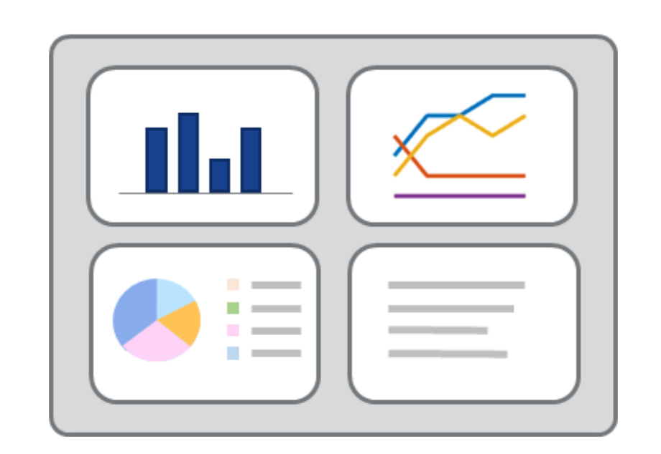
Task 4.1. Robust statistics and visualization
Dashboard
Statistically robust
No misinterpretation
Easy to use
Elucidate cross-variable contingencies
Elucidate time-varying relationships
WP4
WP2
WP5
WP7
Medians/percentiles for box plots
Spearman’s ρ for correlations
Kruskal-Wallis for distributional shifts between contextual items
Mann-Kendall test for trends
…
This project has received funding from the European Union’s Horizon 2020 research and innovation Programme under grant agreement 945263 (IMMERSE)

Slide 4
Task 4.1. Robust statistics and visualization
Dashboard
Statistically robust
No misinterpretation
Easy to use
Elucidate cross-variable contingencies
Elucidate time-varying relationships
WP4
WP2
WP5
WP7
Set of basic statistics for direct implementation and visualization
Documented in deliverable D4.1, shared google document, Jupyter Notebook with pre-implementations in Python
This project has received funding from the European Union’s Horizon 2020 research and innovation Programme under grant agreement 945263 (IMMERSE)

Slide 5
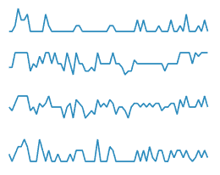
Task 4.2. Machine learning for multimodal data integration
Reconstructing dynamical systems via RNNs
observed
This project has received funding from the European Union’s Horizon 2020 research and innovation Programme under grant agreement 945263 (IMMERSE)

Slide 6

Task 4.2. Machine learning for multimodal data integration
Reconstructing dynamical systems via RNNs
dynamical system
$$x_{t}=f_{θ}(x_{t−1},u_{t},ε_{t})$$
observed
This project has received funding from the European Union’s Horizon 2020 research and innovation Programme under grant agreement 945263 (IMMERSE)
Notes:
One natural approach to connect previous time points to future time points is by modeling these data in terms of dynamical systems;
dynamical systems describe how the state of a system at time point t-1 translates to time point t, potentially given some external influences and noise

Slide 7
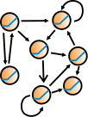

Task 4.2. Machine learning for multimodal data integration
Reconstructing dynamical systems via RNNs
dynamical system
$$x_{t}=f_{θ}(x_{t−1},u_{t},ε_{t})$$
$$y_{t}=g_{λ}(x_{t},η_{t})$$
unobserved
observed
This project has received funding from the European Union’s Horizon 2020 research and innovation Programme under grant agreement 945263 (IMMERSE)

Slide 8
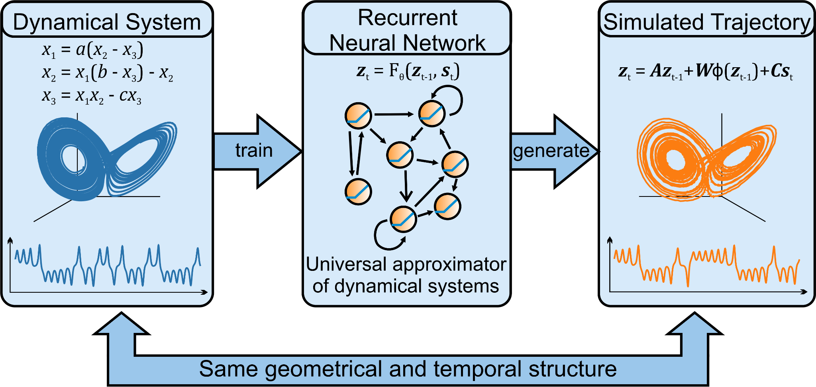
Task 4.2. Machine learning for multimodal data integration
Durstewitz D., Koppe G.. Thurm, M.I. (2022). BioRxiv
Schmidt*, Koppe* et al (2020). ICLR
Koppe et al (2019). PLoS Comput Biol
This project has received funding from the European Union’s Horizon 2020 research and innovation Programme under grant agreement 945263 (IMMERSE)

Slide 9
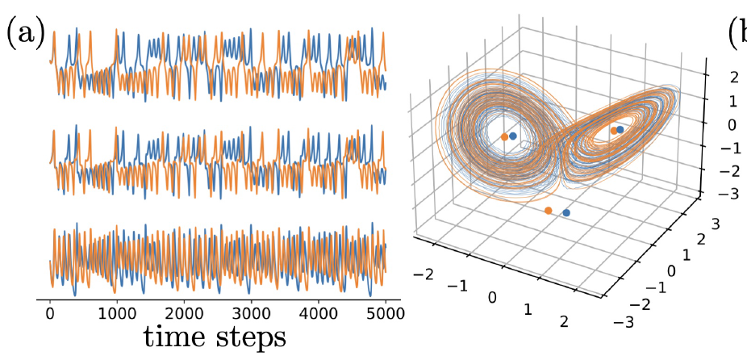
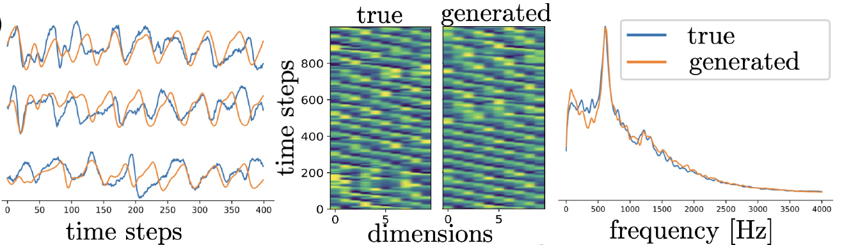
Task 4.2. Machine learning for multimodal data integration
Lorenz-63 (atmospheric convection)
Biophysical bursting neuron model
Neural population model
(Landau & Sompolinsky)
Brenner et al (2022). ICML
This project has received funding from the European Union’s Horizon 2020 research and innovation Programme under grant agreement 945263 (IMMERSE)

Slide 10
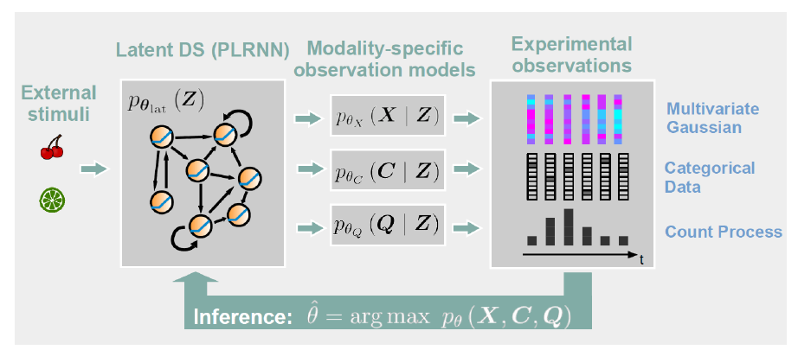
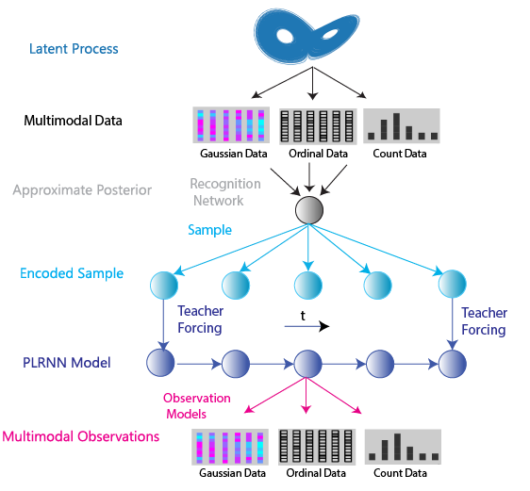
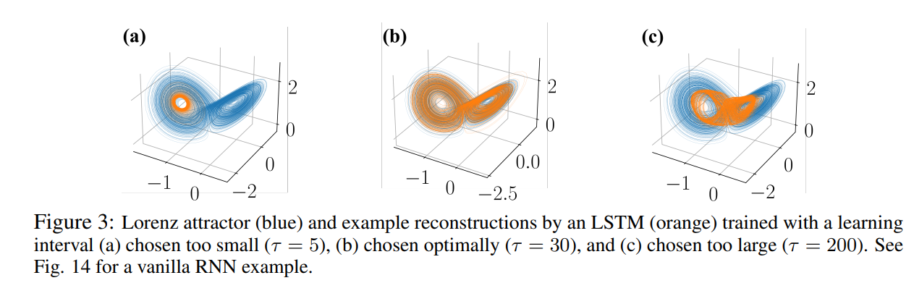
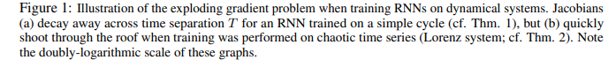
Task 4.2. Machine learning for multimodal data integration
1. Multimodal time series data
MVAE-TF algorithm
Kramer et al 2021, ICML
2. Optimal training on chaotic TS data
Mikhaeil et al 2022, NeurIPS
Brenner et al, accepted, AAAI
This project has received funding from the European Union’s Horizon 2020 research and innovation Programme under grant agreement 945263 (IMMERSE)

Slide 11
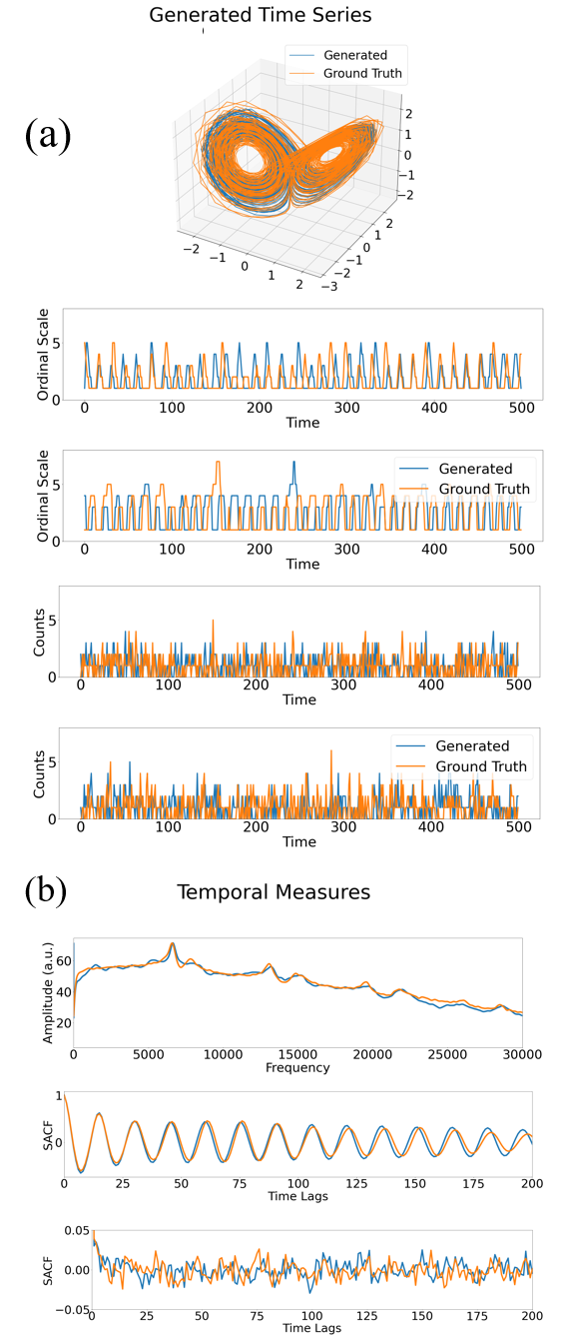
Task 4.2. Machine learning for multimodal data integration
MVAE-TF performance results
Gaussian measurements
Poisson measurements
Ordinal measurements
Brenner et al, accepted, AAAI
This project has received funding from the European Union’s Horizon 2020 research and innovation Programme under grant agreement 945263 (IMMERSE)

Slide 12
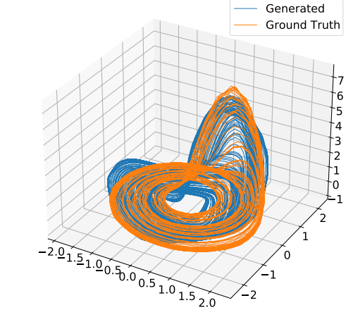
Task 4.2. Machine learning for multimodal data integration
MVAE-TF performance results
Gaussian measurements
Recovering attractor from ordinal measurements alone
Poisson measurements
Ordinal measurements
Brenner et al, accepted, AAAI
This project has received funding from the European Union’s Horizon 2020 research and innovation Programme under grant agreement 945263 (IMMERSE)

Slide 13
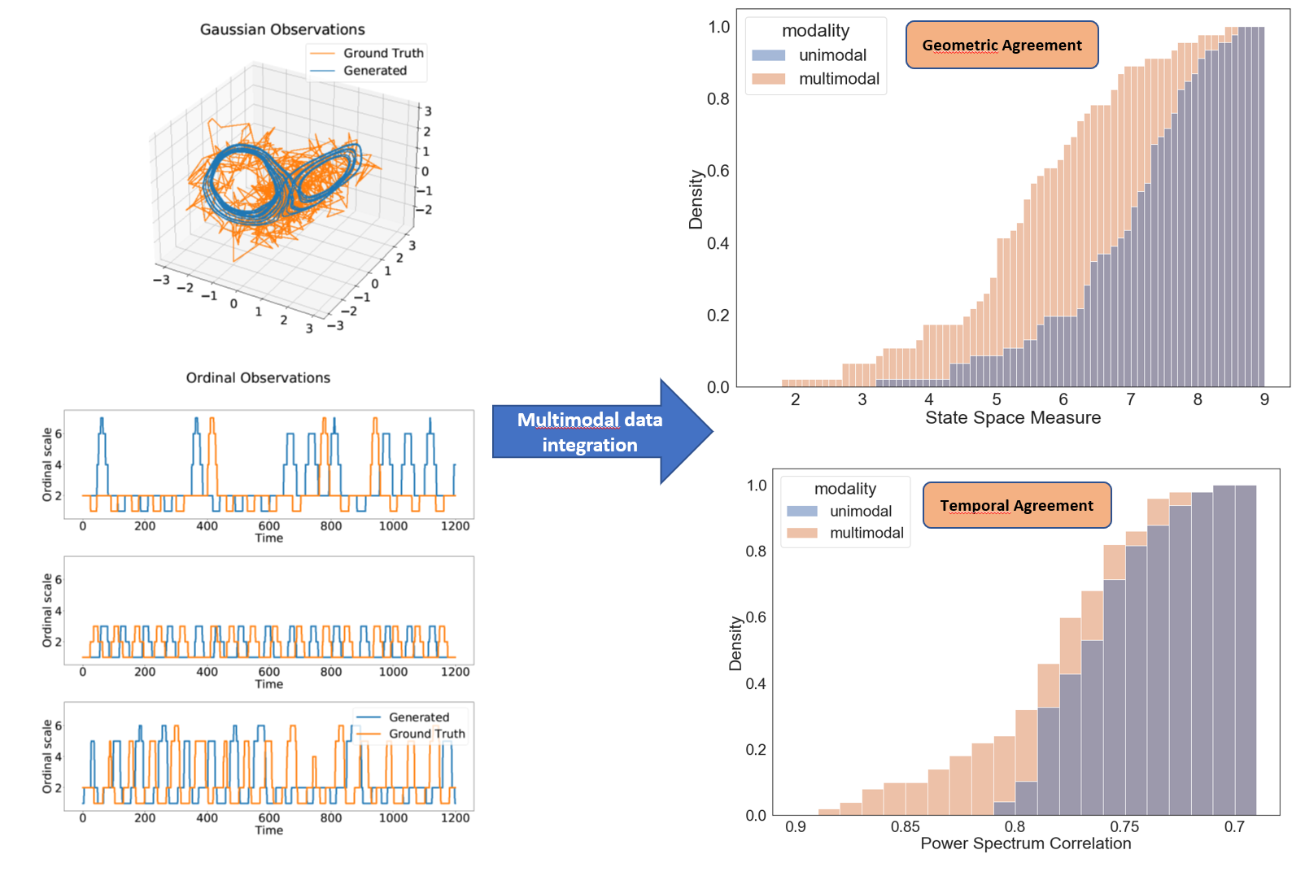
Task 4.2. Machine learning for multimodal data integration
MVAE-TF works on highly noisy data and outperforms unimodal approaches
Brenner et al, accepted, AAAI
This project has received funding from the European Union’s Horizon 2020 research and innovation Programme under grant agreement 945263 (IMMERSE)

Slide 14
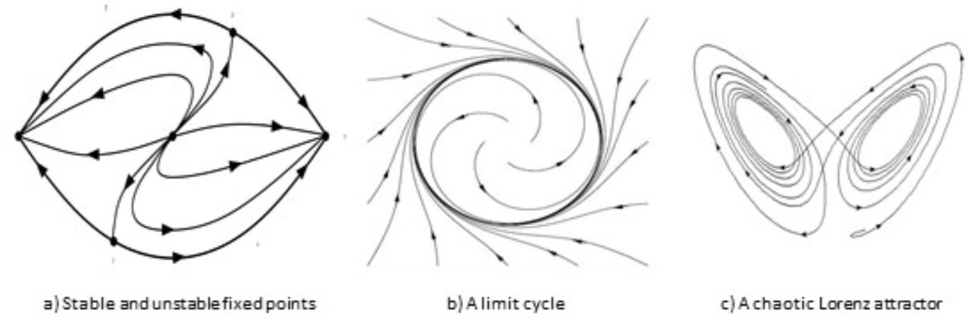
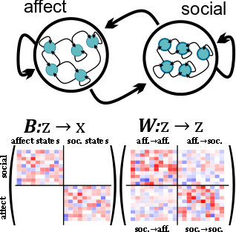

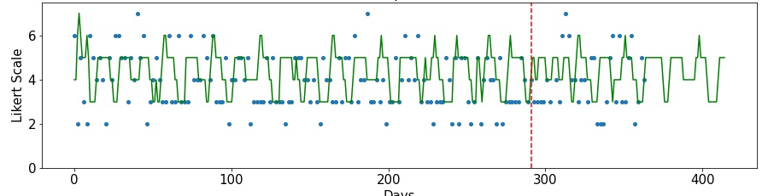
Behavioral contingencies and optimal leveraging points
3 levels of interpretability
Durstewitz D., Huys, Q., Koppe G. (2021). BP:CNNI
Durstewitz D., Koppe G., Thurm, M.I. (2022). BioRxiv
This project has received funding from the European Union’s Horizon 2020 research and innovation Programme under grant agreement 945263 (IMMERSE)

Slide 15
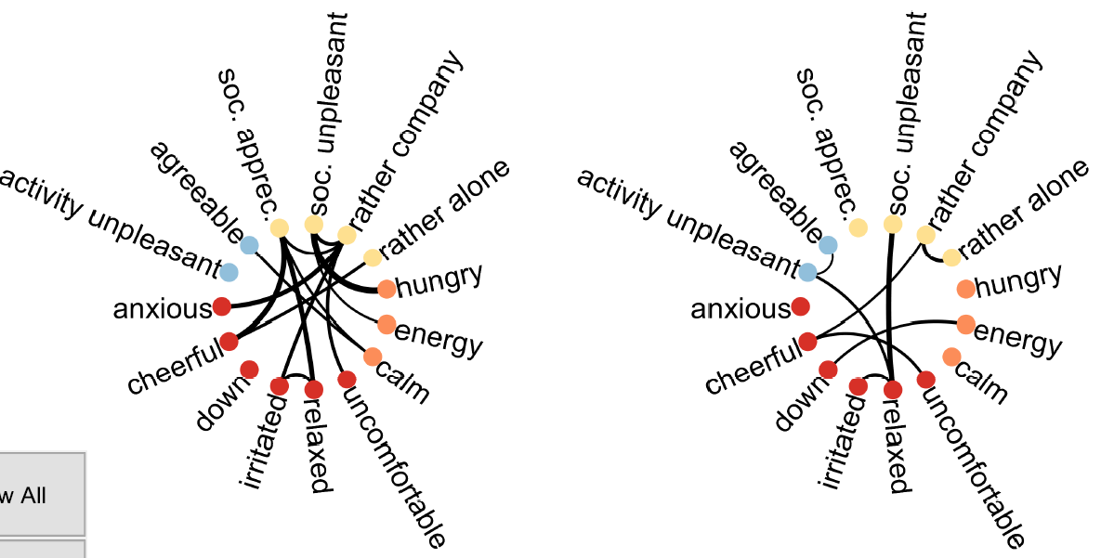
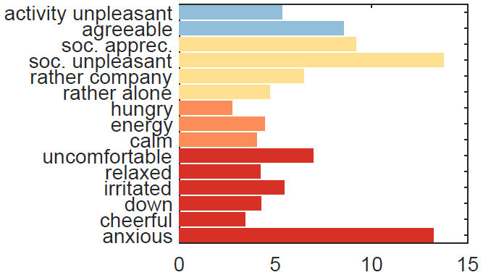
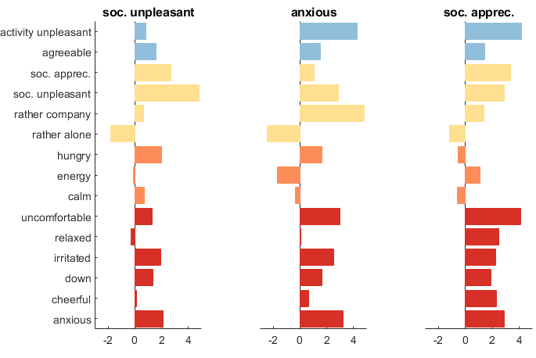
Behavioral contingencies and optimal leveraging points
Behavioral contingencies
Optimal leveraging points
(identification of control nodes)
excitatory
inhibitory
Average controllability
Long-term behav. of control nodes
Experience sampling networks (N=10)
Fechtelpeter, …, Durstewitz, Reininghaus, Koppe, in prep
This project has received funding from the European Union’s Horizon 2020 research and innovation Programme under grant agreement 945263 (IMMERSE)

Slide 16
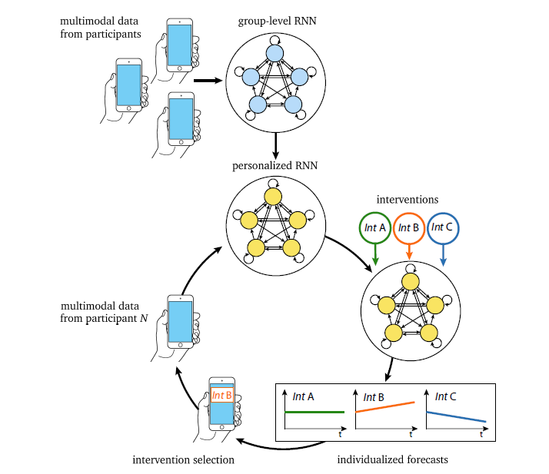
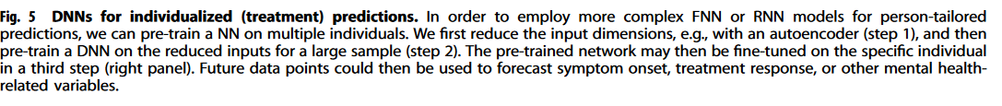
4.3 Development of cross-site big data integration framework
General framework: network pre-training on large sample
Unai Fischer Abaigar, MSc
This project has received funding from the European Union’s Horizon 2020 research and innovation Programme under grant agreement 945263 (IMMERSE)

Slide 17
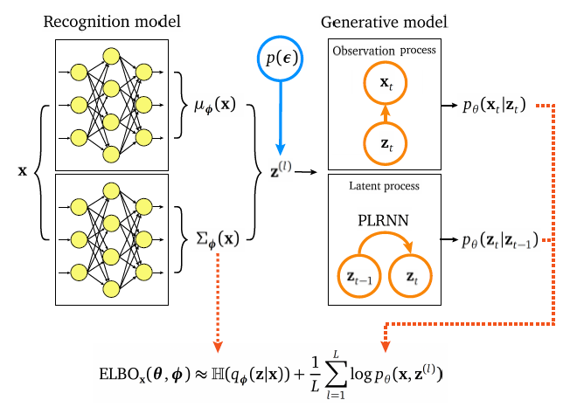
4.3 Development of cross-site big data integration framework
General framework: network pre-training on large sample
Group level parameter
Subject level parameter
Unai Fischer Abaigar, MSc
This project has received funding from the European Union’s Horizon 2020 research and innovation Programme under grant agreement 945263 (IMMERSE)

Slide 18
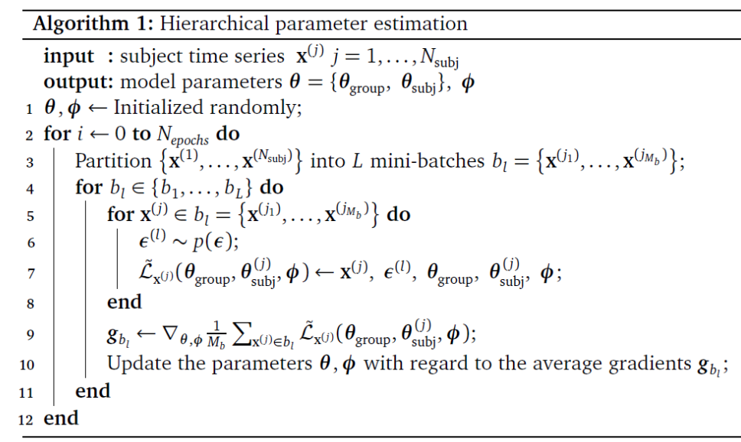
4.3 Development of cross-site big data integration framework
General framework: network pre-training on large sample
Group level parameter
Subject level parameter
Unai Fischer Abaigar, MSc
This project has received funding from the European Union’s Horizon 2020 research and innovation Programme under grant agreement 945263 (IMMERSE)

Slide 19
WP4 – Deliverables & Milestones
Milestone / deliverable | Title | Original deadline | Status
D4.1 | Set of basic statistics for direct implementation and visualization | Month 9 | ✅
MS14 | Identification of interpretable behavioral traits and contingencies in personalized DTSM models | Month 24 | Ongoing
D4.2 | Algorithms and software environment for DTSM-based multimodal big data integration | Month 36 | Ongoing (✅)
MS18 | Development of multi-site big data approach for ESM and DTSM models | Month 30 | Ongoing
MS24 | Cross-site validation of big data approach | Month 40 | Not yet started
D4.3 | Software for identification, visualization, and feedback of behavioral contingencies | Month 48 | Not yet started
This project has received funding from the European Union’s Horizon 2020 research and innovation Programme under grant agreement 945263 (IMMERSE)

Slide 20
WP4 – Challenges, delays, and solutions
Challenge | Solution
Noisy data | Statistical models (e.g. variational autoencoders)
Multiple data distributions | Flexible observation models (e.g. cumulative link, zero-inflated Poisson)
Complex (chaotic) dynamics | Training via sparse teacher forcing
Small sample sizes | Hierarchisation of training algorithm, multimodal data
Multiple time scales | Manifold attractor regularization
Unreliable self-report | Integration of different data modalities (step counts, GPS)
Irregular sampling | Continuous time models (Neural ODE), multimodal data
Missing values | Generative models, multimodal data
Non-stationary dynamics | Non-stationary PLRNN (with time-varying parameters)
This project has received funding from the European Union’s Horizon 2020 research and innovation Programme under grant agreement 945263 (IMMERSE)

Slide 21
WP4 – Next steps
Validate hierarchical estimation in MVAE-TF
Analyze data from the consortium
Implement cross-site validation scheme
This project has received funding from the European Union’s Horizon 2020 research and innovation Programme under grant agreement 945263 (IMMERSE)

