Slide 1
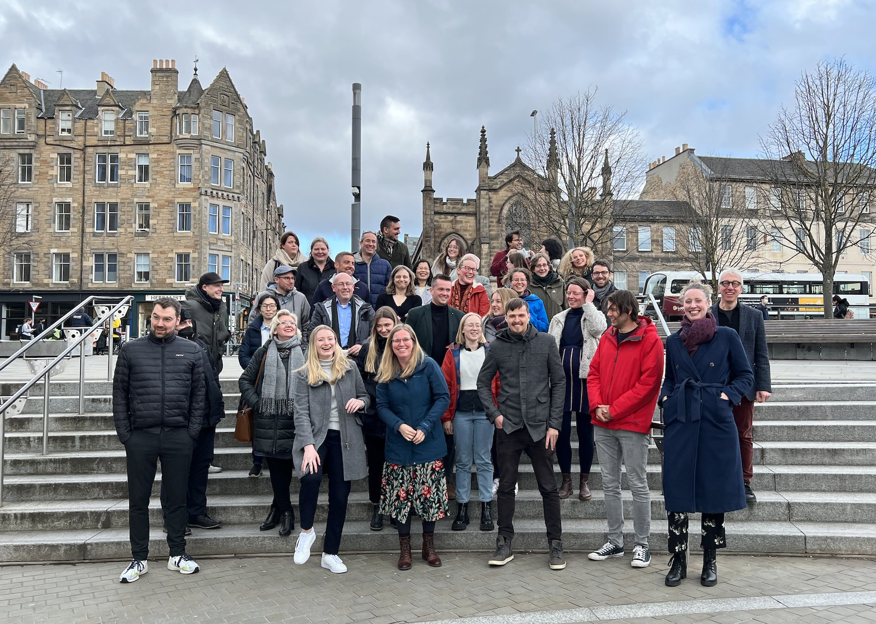
WP5 Stakeholder Experience
Dr Maria Wolters
UEDIN, CIMH, KUL, UKBA, UJPS
EC Evaluation December 1st
This project has received funding from the European Union’s Horizon 2020 research and innovation Programme under grant agreement 945263 (IMMERSE)

Slide 2
WP5 – Overview, objectives, and aims
To determine actionable requirements that ensure a good user experience
To understand how service users appropriate DMMH
T5.1: Establishing the Technology Context (Survey)
T5.2: Establishing Context of Self-Tracking and ESM (Interviews)
T5.3: Tracking Users’ Appropriation of DMMH
This project has received funding from the European Union’s Horizon 2020 research and innovation Programme under grant agreement 945263 (IMMERSE)

Slide 3
WP5 – Theoretical Framework
NASSS (Greenhalgh et al): Non-Adoption, Abandonment, Challenges to Scale-up, Spread and Sustainability
Domains
Illness / condition (mental health, transdiagnostic)
Technology (MoMent + Dashboard = IMMERSE)
Value Proposition (aspect of benefit)
Adopter system (patients, clinicians, supporters, admin)
Organisations (sites)
Wider system (health care system, policy)
This project has received funding from the European Union’s Horizon 2020 research and innovation Programme under grant agreement 945263 (IMMERSE)

Slide 4
WP5 – Relationship with Other WPs
WP5 - Ideation, Feedback, Validation
WP7 – Intervention Implementation Strategies
WP2 – DMMH Implementation
WP1: Greases the wheels
WP3: Data Management
WP4: Visualisations
WP8: Interface with other project members who want to use data generated in Phase I
WP6: Ethical Approvals
This project has received funding from the European Union’s Horizon 2020 research and innovation Programme under grant agreement 945263 (IMMERSE)

Slide 5
WP5 – Data Collection Structure
Survey
Interview
Overall patterns (NASSS), assessment of DMMH based on brief description
More in-depth understanding based on demonstration of MoMent app (patients) and dashboard (clinicians)
Generic
Specific:
MoMent App
Dashboard
This project has received funding from the European Union’s Horizon 2020 research and innovation Programme under grant agreement 945263 (IMMERSE)

Slide 6
WP5 – Survey Recruitment (as of August 5, 2022)
Country | Patients | Supporters | Clinicians | Admin | Total
Belgium | 67 | 18 | 63 | 22 | 170
Germany | 215 | 38 | 45 | 12 | 310
Slovakia | 103 | 12 | 45 | 10 | 151
UK | 115 | 18 | 13 | 1 | 138
Total | 500 | 75 | 147 | 45 | 767
Minimum | 100 | 50 | 25 | 10 | 185
Full | 400 | 200 | 100 | 40 | 740
This project has received funding from the European Union’s Horizon 2020 research and innovation Programme under grant agreement 945263 (IMMERSE)

Slide 7
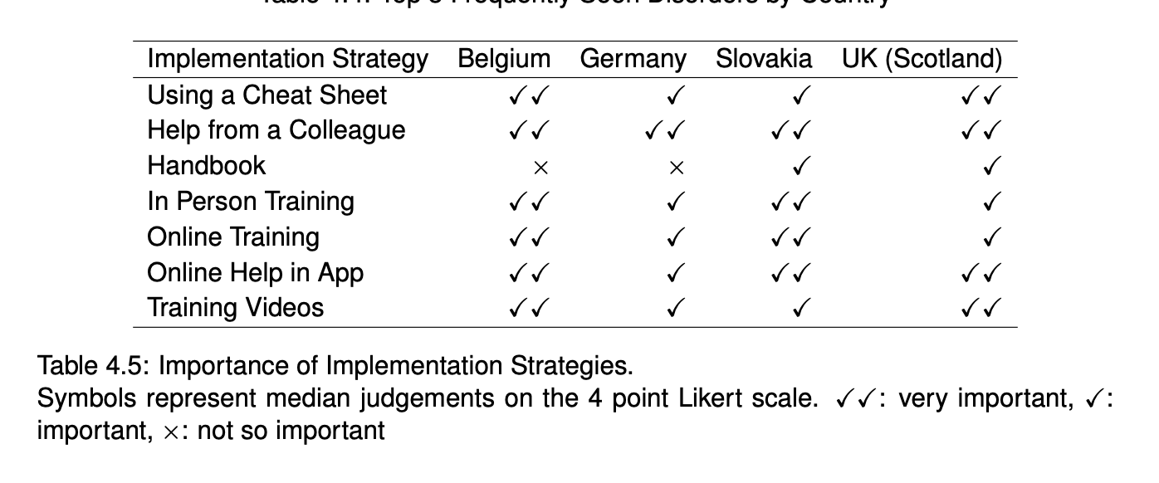
WP5 – Implementation Strategies for Clinicians
This project has received funding from the European Union’s Horizon 2020 research and innovation Programme under grant agreement 945263 (IMMERSE)

Slide 8
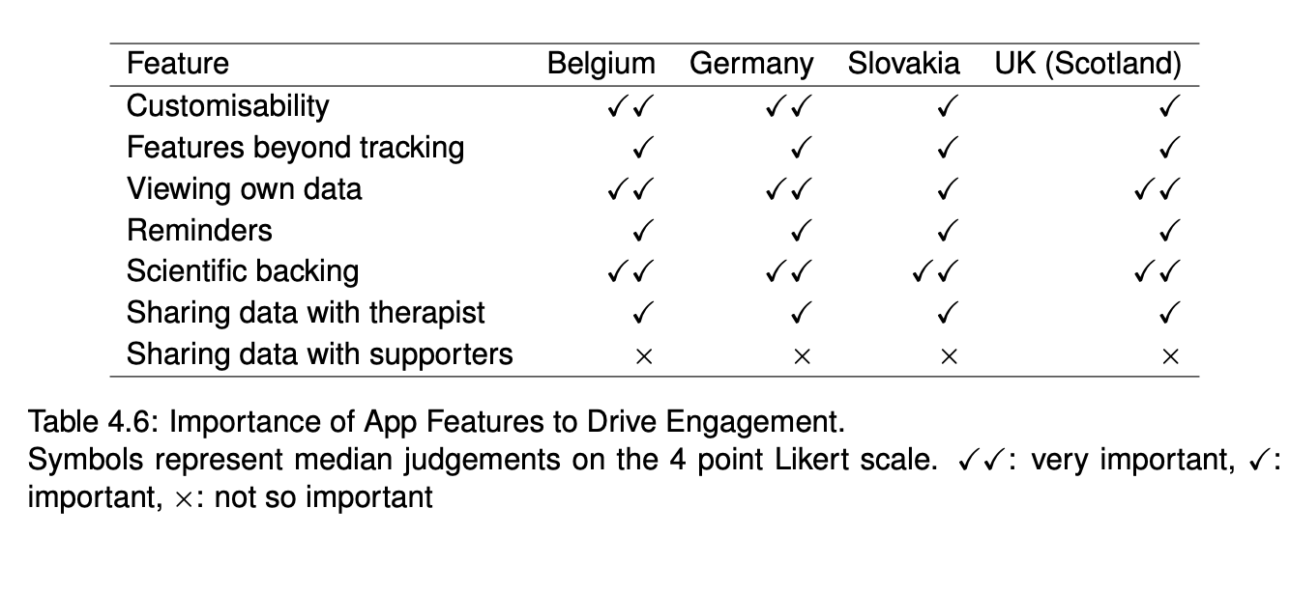
WP5 – Features Desired by Patients
This project has received funding from the European Union’s Horizon 2020 research and innovation Programme under grant agreement 945263 (IMMERSE)

Slide 9
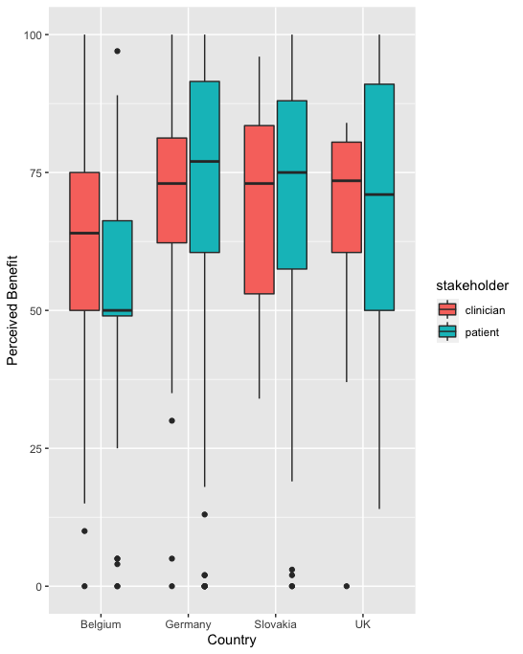
WP5 – Perceived Potential Benefits
This project has received funding from the European Union’s Horizon 2020 research and innovation Programme under grant agreement 945263 (IMMERSE)

Slide 10
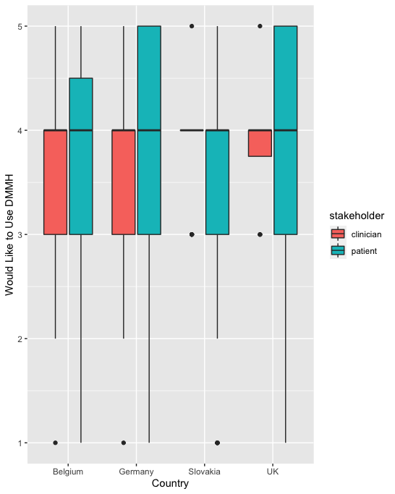
WP5 – Intended Adoption
This project has received funding from the European Union’s Horizon 2020 research and innovation Programme under grant agreement 945263 (IMMERSE)

Slide 11
WP5 – Interviews
This project has received funding from the European Union’s Horizon 2020 research and innovation Programme under grant agreement 945263 (IMMERSE)

Slide 12
WP5 – Interviews
This project has received funding from the European Union’s Horizon 2020 research and innovation Programme under grant agreement 945263 (IMMERSE)

Slide 13
WP5 – Deliverables & Milestones
Milestone / deliverable | Title | Original deadline | Status
D5.1 | Report on Self-Tracking Context and Technology Practices | M18 / September 30, 2022 | ✅
D5.2 | Report on User Experience during Deployment | M48 / March 31, 2025 | ongoing
MS6 | feedback report | M12 | ✅
This project has received funding from the European Union’s Horizon 2020 research and innovation Programme under grant agreement 945263 (IMMERSE)

Slide 14
WP5 – Challenges, delays, and solutions
Covid-19 delayed recruitment
→ extension of recruitment deadlines
Ethical Approval and Data Sharing Agreement delayed analysis
→ focus on developing replicable analysis framework informal feedback mechanisms
This project has received funding from the European Union’s Horizon 2020 research and innovation Programme under grant agreement 945263 (IMMERSE)

Slide 15
WP5 – Replicable Analysis Framework
Statistical Analysis:
R – open-source framework with excellent Python integration (WP4)
R Markdown - fully documented for open science
Qualitative Content Analysis:
Metadata
Memos
Ease of archiving and interchange
This project has received funding from the European Union’s Horizon 2020 research and innovation Programme under grant agreement 945263 (IMMERSE)

Slide 16
WP5 – Informal Feedback Mechanisms
Expert Assessment
Based on informal initial analyses
In-depth assessment
Memo Writing:
Memoranda / research diaries are traditional qualitative method
Interviewers were also closely involved in developing intervention and implementation
This project has received funding from the European Union’s Horizon 2020 research and innovation Programme under grant agreement 945263 (IMMERSE)

Slide 17
WP5 – Dissemination
Social Media
Publications to come
This project has received funding from the European Union’s Horizon 2020 research and innovation Programme under grant agreement 945263 (IMMERSE)

Slide 18
WP5 – Next steps (T5.1/T5.2)
Survey:
Integrate final data from UK patients and free text coding
Publish key analyses for Survey Data
Interviews:
Complete coding of interviews, driven by individual research questions
Share best practice with WP7 for qualitative process
Publish results in mixed methods / qualitative papers
This project has received funding from the European Union’s Horizon 2020 research and innovation Programme under grant agreement 945263 (IMMERSE)

Slide 19
WP5 – Next steps (T5.3)
Define and code use-based metrics
WP2 (metrics collected by Movisens), WP4 (integration with analysis), WP7 (implications for evaluation; integration with blinding), WP3 (data access)
Qualitative Evidence
Liaise with WP7 and support evaluation interview analysis
This project has received funding from the European Union’s Horizon 2020 research and innovation Programme under grant agreement 945263 (IMMERSE)

