Slide 1




WP7
Implementation strategies, processes, outcomes, and costs
Ulrich Reininghaus
Department of Public Mental Health, CIMH
Michel Wensing
Department of General Medicine and Health Services Research, UKHD
EC Evaluation, 01.12.2022
This project has received funding from the European Union’s Horizon 2020 research and innovation Programme under grant agreement 945263 (IMMERSE)
Notes:
In my talk, I will provide a brief overview of…
…the aims and methodology of WP7…
…and what we have achieved so far in this work package
In WP7, we look,…
…on the one hand, at tailoring and optimizing strategies for implementing the Digital Mobile Mental Health intervention…
…and, on the other, at evaluating processes, outcomes and costs of this implementation

Slide 2





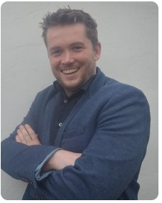




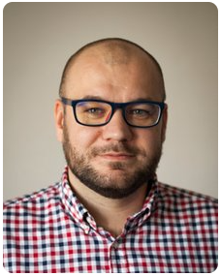
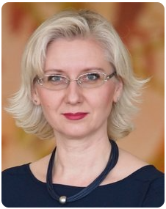





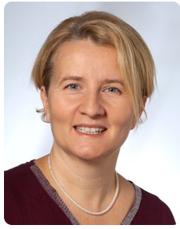
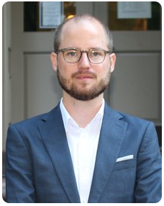




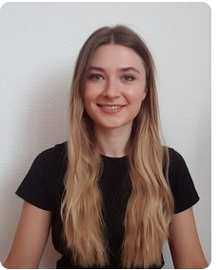
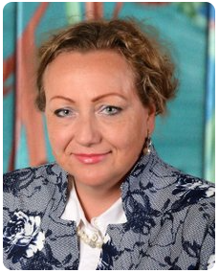





WP7 - Team
This project has received funding from the European Union’s Horizon 2020 research and innovation Programme under grant agreement 945263 (IMMERSE)
Notes:
Now, work package 7 is led by Michel Wensing and myself, and coordinated by the amazing Anita Schick as postdoctoral coordinator
The management structure further includes an amazing team of local PIs – namely Iveta Nagyova in Kosice, Michal Hajduk and Anty Heretik in Bratislava, Matthias Schwannauer in Edinburgh, Glenn Kiekens in Leuven, and myself in Mannheim
As local PIs we are responsible…
…not only for delivering work package 7 across 8 clinical sites
…but also centrally supporting all other work packages in any work that requires involvement of the clinical sites
Further, we are very privileged to have Manuela de Allegri on board, who leads the economic evaluation.
…and we are extremely fortunate to work with a truly amazing team of postdoctoral and doctoral researchers as well as clinician scientists across all sites
…and I cannot tell you how grateful I am for this collaboration in our work package!

Slide 3
WP7 – Aims, objectives
To tailor and optimize detailed implementation strategies for the Digital Mobile Mental Health intervention (DMMH) at 8 sites across 4 European countries (task 7.1 and D7.1; M1-18, participatory field study, with WP5)
To investigate i) Reach, ii) Effectiveness, iii) Adoption, iv) Implementation and v) Maintenance of implementing the DMMH in routine care (RE-AIM) as a basis for establishing the public health impact of the DMMH intervention and implementation (task 7.2; M1-18, preparation (D7.2), with WP2, WP3, and WP6; M19-54, cRCT)
To examine the process of implementing the DMMH in routine care and identify in vivo configurations of contexts and mechanisms, and how these are associated with outcomes of implementation and intervention (task 7.3; M1-18, preparation (D7.2); M19-54, data collection)
To investigate the economic costs of implementing the DMMH intervention, determine cost-utility and extended cost-utility of the intervention vis à vis standard care (task 7.4; M1-18, preparation (D7.2); M19-54, data collection)
This project has received funding from the European Union’s Horizon 2020 research and innovation Programme under grant agreement 945263 (IMMERSE)
Notes:
In WP7 we have four key aims that we have started to pursue in the first 1.5 years of the project.
First of all, we aim to tailor and optimize strategies for implementing the Digital Mobile Mental Health intervention (DMMH) at our 8 clinical sites across the 4 European countries–
this is what task 7.1 is about – and deliverable D7.2 is linked to this
this has been a strong focus in the first 18 months
We further aim to establish public health impact of the DMMH intervention and its implementation in routine care –
operationalized here as i) Reach, ii) Effectiveness, iii) Adoption, iv) Implementation and v) Maintenance
this is what task 7.2 is about
for which we have completed an enormous amount of preparatory work as reflected in deliverable D7.2
closely collaborated with WP2, WP3, and WP6 in our preparatory work
We have just started to conduct a cluster RCT
Further, the process and economic evaluation nested within this trial will provide in-depth insights into in-vivo context, mechanism, and outcome configurations as well as economic costs
this is what task 7.3 and 7.4 focus on
…and, again, an enormous amount of preparatory work has gone into this over the first 18 months

Slide 4











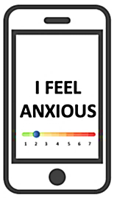

Phase I
Participatory field study (task 7.1, month 1-18, with WP5)
WP7 – Design, Methods
Phase II (M19-54)
Pragmatic, multi-centre, parallel-group cluster randomized controlled trial (cRCT; task 7.2)
6-month intervention period
Service users
Clinicians
Service users’ network
IT / health care management
DMMH intervention + implementation strategies + TAU
Randomization
initial 2 months
(focused delivery)
n = 24 clinical units
(16:8 ratio)
6-month maintenance period
TAU
n = 24 clinical units across 8 sites [3 units per site]
n = 432 service users [18 service users per unit, 54 service users from 3 units per site]
n = 100 clinicians [from 24 units across 8 sites]
Baseline (t₀)
2-month
post-baseline (t₁)
6-month
post-baseline (t₂)
12-month
post-baseline (t₃)
Process evaluation (task 7.3) + economic evaluation (task 7.4) of implementing the DMMH in routine care
This project has received funding from the European Union’s Horizon 2020 research and innovation Programme under grant agreement 945263 (IMMERSE)
Notes:
To achieve our aims, we adopt a highly innovative, two-phase participatory, evaluation and implementation science approach
In the first phase, we conducted the participatory field study that I’ve just mentioned in service users, clinicians, the support network of service users and IT/health care management
Maria Wolters will report the findings from this field study later on
Based on findings from this study, we tailored and optimized implementation strategies in task 7.1
In phase II, we address task 7.2-7.4 and – after completing preparatory work in the first 18 months – we have just started to conduct a cluster Randomized Controlled Trial (cRCT)
In this trial, 24 clinical units are randomized – as the cluster and unit of randomization – based on a 2:1 (or 16:8) ratio…
…to either the experimental condition, in which service users and clinicians will receive the DMMH and implementation strategies in addition to treatment as usual
…or to the control condition, in which service users and clinicians will continue to have access to, or deliver, TAU
We assess outcomes at baseline as well as 2-month, 6-month, and 12-month post-baseline by blinded assessors as per ethically approved study protocol…
…with the primary outcome being service user engagement at 2-month post-baseline.
This is what the trial has been powered on
Our sample size calculation yielded that a sample size of 432 service users is required to detect a difference between experimental and control condition of 0.4 in the service user engagement scale, with a power of 80% at p<0.05.

Slide 5
WP7 – Delivery of task 7.1
Task 7.1 Optimizing the DMMH implementation strategies
Specification and optimization of implementation strategies
Based on phase 1 data (led by WP5): recruitment/data collection in 4 countries
Consultation process with clinical sites
Final set:
  Technological system (led by WP2)
  Intervention manual
  Training/support package and feedback for clinicians
  Counselling and reminders for service users
  Organizational implementation strategies
This project has received funding from the European Union’s Horizon 2020 research and innovation Programme under grant agreement 945263 (IMMERSE)
Notes:
So, turning now to delivery of task 7.1 over the past 18 months
Here we have specified and optimized the strategies for implementing the DMMH intervention at the 8 clinical sites, in which we conduct the cRCT
We did so based on data collected in the participatory field study in phase I
for which we supported recruitment and data collection in the four countries
We also conducted a detailed consultation process at clinical sites for tailoring the implementation strategies
The final set includes
Technological system (with WP2)
Intervention manual
Training and support package for clinicians (incl. feedback on key performance indicators)
Counselling and reminders for service users
Organizational implementation strategies

Slide 6
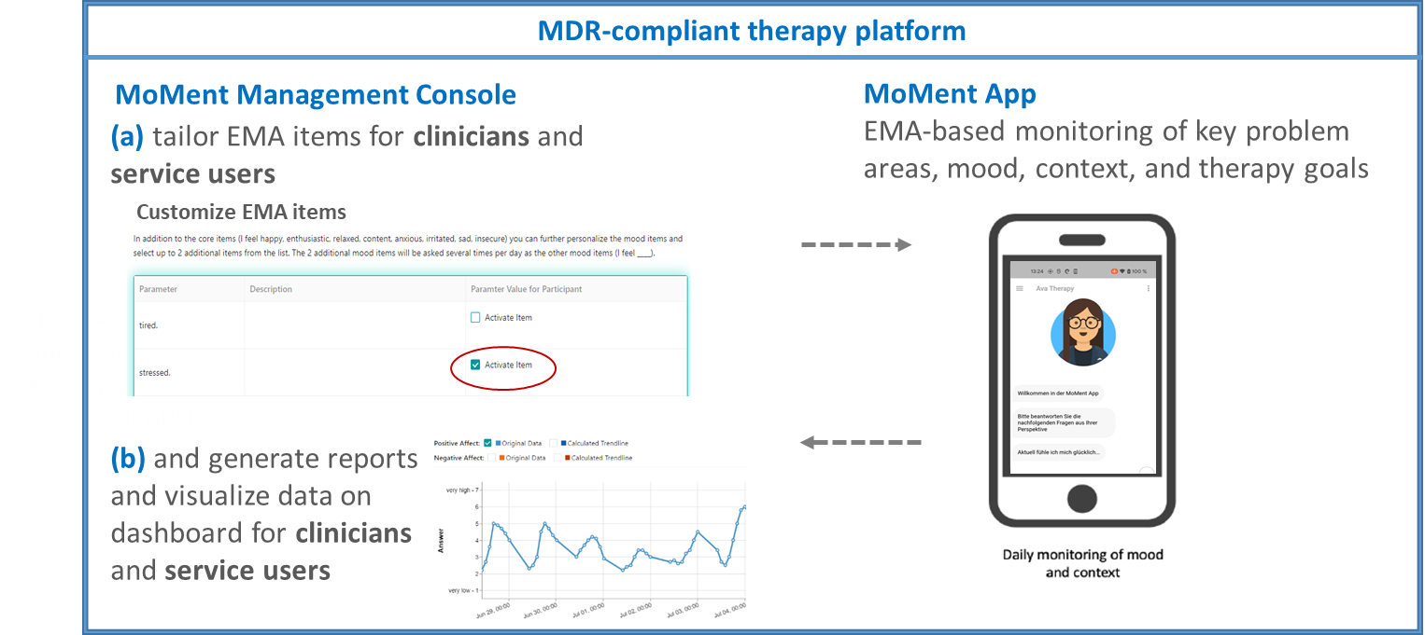
WP7 – Delivery of task 7.1
Task 7.1 Optimizing the DMMH implementation strategies
1. Technological system (led by WP2)
This project has received funding from the European Union’s Horizon 2020 research and innovation Programme under grant agreement 945263 (IMMERSE)
Notes:
Development of the technological system was led by WP2 –
Simon Krause will tell you more about this later on!
In short, the system has two core components:
One the one hand, the MoMent management console, which…
…allows to personalize experience sampling items
as well as to generate reports and visualize experience sampling data on a dashboard
On the other, the MoMent App
which allows for experience sampling-based monitoring of hey problem areas, mood, context and therapy goals
We - as WP7 - contributed to this technological system our
methodological expertise in Experience Sampling Methodology and
domain expertise in mental health
Specifically, we have developed and customized experience sampling content for the prototype
We further contributed…
…to the development of the prototype in an iterative process to capture needs of users, clinicians, and health care management
…to the regulatory process for DMMH technological system, including…
…specification of requirements for protoype (definition of intended purpose/use, completed risk management)
…and we also completed the usability testing of the prototype with stakeholders

Slide 7

WP7 – Delivery of task 7.1
Task 7.1 Optimizing the DMMH implementation strategies
2. Intervention manual (in line with Template for Intervention Description and Replication (TIDieR) checklist)
This project has received funding from the European Union’s Horizon 2020 research and innovation Programme under grant agreement 945263 (IMMERSE)
Notes:
We also compiled an intervention manual
This describes, for example, the structure of a core module and add-on modules
…also, provides guidance for clinicians, for instance, on how to deliver the feedback sessions with patients
…and explains reports and visualizations provided by the dashboard to clinicians
Just to build up some tension here - there is an interesting finding on clinicians’ views about manuals from the participatory field study that Maria will present

Slide 8
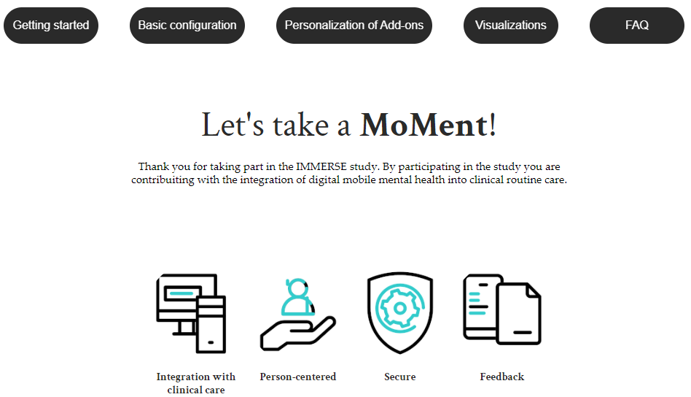
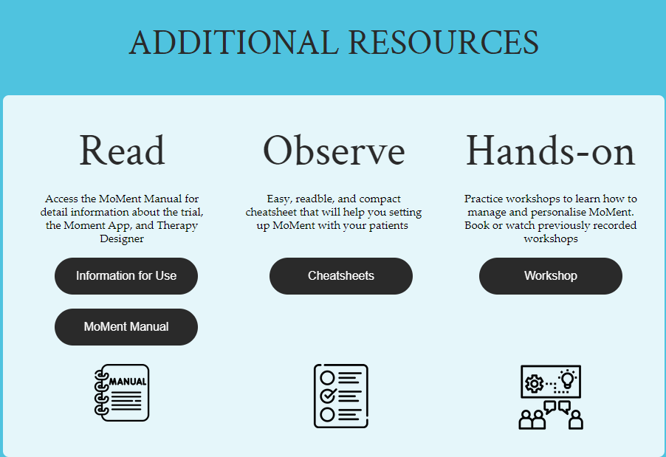
WP7 – Delivery of task 7.1
Task 7.1 Optimizing the DMMH implementation strategies
3. Training and support package for clinicians
  Monthly feedback on key performance indicators (use of dashboard/app, number of users, number of feedback sessions etc.)
This project has received funding from the European Union’s Horizon 2020 research and innovation Programme under grant agreement 945263 (IMMERSE)
Notes:
The third implementation strategy is a training and support package for clinicians
This package includes workshops for clinicians
for these workshops, we have standardized the core content across sites
…we allow for additional content that addresses local needs and healthcare systems in each of our sites
We also allow for optional delivery of content as individual training sessions
…and offer optional refresher workshops
The support package further includes a quick guide/cheat sheets and the Information For Use (IFU)
We also provide monthly feedback to clinicians on key performance indicators (such as use of dashboard/app, number of users seen, number of feedback sessions delivered etc.)

Slide 9
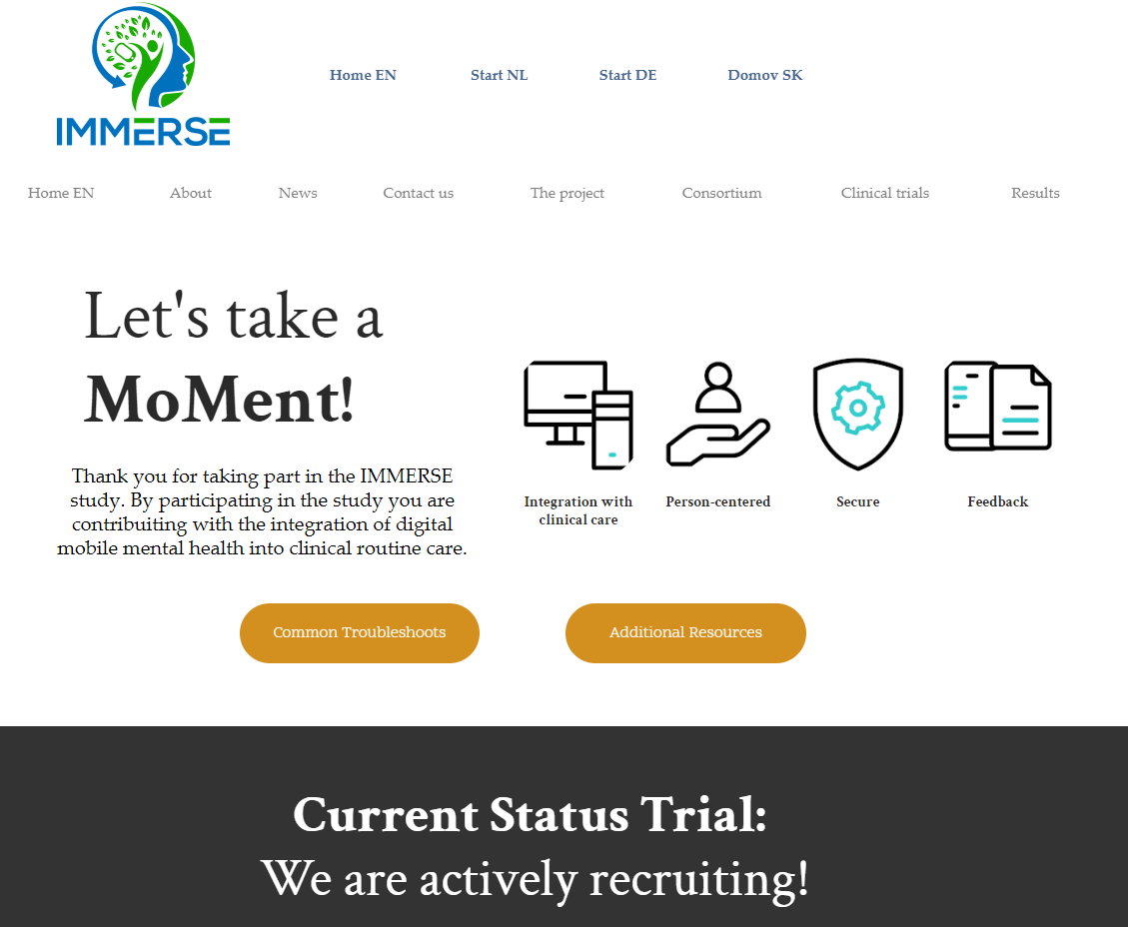

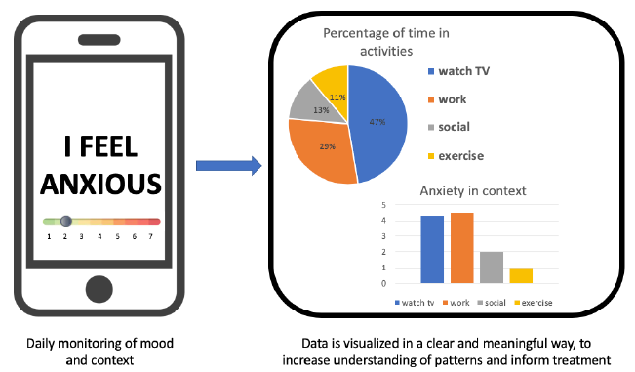
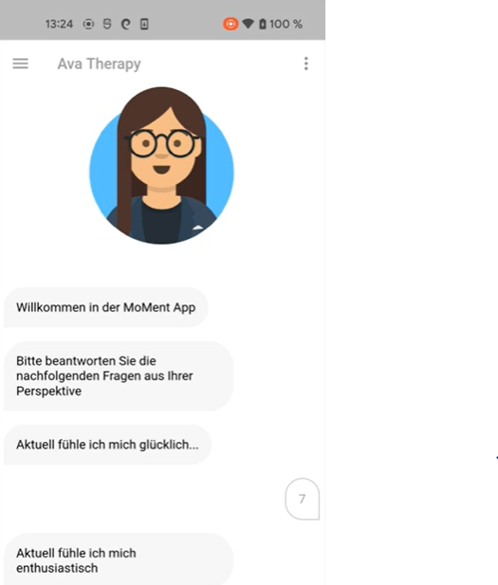
WP7 – Delivery of task 7.1
Task 7.1 Optimizing the DMMH implementation strategies
4. Manualized package of counselling and reminders
MoMent App
This project has received funding from the European Union’s Horizon 2020 research and innovation Programme under grant agreement 945263 (IMMERSE)
Notes:
Our fourth set of implementation strategies is a manualized package of tailored information, counselling, and reminders
This includes
support of users in the on-boarding to the MoMent App
named individual for technical support at each site
phone check-ins
website (FAQ, videos)
Feedback sessions with clinicians
Information For Use (IFU)

Slide 10
WP7 – Delivery of task 7.1
Task 7.1 Optimizing the DMMH implementation strategies
5. Organizational implementation strategies
  Involvement of healthcare management (from outset)
    Meetings with managers and directors at each site (n=42)
    Meetings with managers and directors across sites
  Involvement of team leads/line managers
  Identification of opinion leaders: involvement in implementation, delivery of DMMH, and communication/training
  Feedback on key performance indicators to management
This project has received funding from the European Union’s Horizon 2020 research and innovation Programme under grant agreement 945263 (IMMERSE)
Notes:
Our fifth set of implementation strategies addresses the organizational level
…and in developing organizational implementation strategies we involved healthcare management of our clinical sites
On the one hand, through a total of 42 meetings with managers and directors at each site
…on the other, meetings across sites
Now that we have started with the cRCT,…
…we have started to involve team leads/line managers
we have identified opinion leaders (through workshops):
We are keen for them to promote the implementation and delivery of DMMH, and facilitate communication and training
We have also started to provide feedback on key performance indicators to team leads and line managers
Completion of task 7.1 resulted in the submission of the respective deliverable D7.1

Slide 11




WP7 – Delivery of task 7.2 (ongoing)
Task 7.2 Implementation outcomes evaluation
Completion of complex research ethics/regulatory process for other clinical investigation (MDR 2017/745, §82; with WP2, WP3, and WP6)
This project has received funding from the European Union’s Horizon 2020 research and innovation Programme under grant agreement 945263 (IMMERSE)
Notes:
We also completed intense preparatory work for task 7.2 over the first 18 months
This included completing an intense and complex research ethics and regulatory process for conducting our cluster Randomized Controlled Trial as other clinical investigation (MDR 2017/745, §82)
GCP training of staff according to ISO 14155
Clinical Investigation Plan (CIP) in line with regulatory requirements
Completion of participant information sheets (PIS), informed consent forms (ICF), investigators brochure (IB), information for use (IFU) in 4 languages
Notification of competent authorities (BfARM, FAGG, SUKL), where required

Slide 12
WP7 – Delivery of task 7.2 (ongoing)
Task 7.2 Implementation outcomes evaluation
Completion of research governance procedures across 8 sites in 4 countries (!) (with WP3 and WP6)
Implementation of all outcome measures in all languages in eCRF system
Compilation of Investigator Site Files (ISFs) and Trial Master File (TMF) for cRCT as other clinical investigation (MDR 2017/745, §82)
Completion of Site Initiation Visits (SIVs)
Completion of ‘first study subject approval package’ (deliverable 7.2)
This project has received funding from the European Union’s Horizon 2020 research and innovation Programme under grant agreement 945263 (IMMERSE)
Notes:
We further completed an similarly intense and complex research governance procedures across 8 sites in 4 countries (!)
12 contracts across 16 legal departments (7 for investigator site contracts; 9 for DPA (all consortium partners))
We defined and implemented all outcome measures in all languages in a validated electronic Case Report Form system
We compiled the Investigator Site and Trial Master Files
Completed site initiation visits for all sites
…and finally completed the first study subject approval package – which reflects deliverable 7.2
This includes
Final version of Clinical Investigation Plan (CIP)
Registration of cRCT in ISRCTN (https://doi.org/10.1186/ISRCTN15109760)
All ethics approvals
Confirmation of notification of competent authorities

Slide 13
WP7 – Delivery of task 7.3/7.4 (ongoing)
Task 7.3 Implementation process evaluation
Prepared the process evaluation on implementation and maintenance of DMMH
  Development of programme theory based on focus group data
  Development and piloting of interview guide
Task 7.4 Economic evaluation
Measures for the assessment of costs
Implementation in eCRF in all languages
This project has received funding from the European Union’s Horizon 2020 research and innovation Programme under grant agreement 945263 (IMMERSE)

Slide 14
WP7 – Deliverables & Milestones
Milestone / deliverable | Title | Original deadline | Status
MS 9 | Tailoring and optimization of DMMH intervention and implementation strategies and guidelines for semistructured interviews finalized | Month 19 / 31.10.2022 | ✅
D7.1 | Consolidated description of intervention and implementation strategies | Month 19 / 31.10.2022 | ✅
MS 10 | Preparation of clincial trial completed | Month 19 / 31.10.2022 | ✅
D7.2 | Completion of ‘first study subject approval package’ | Month 19 / 31.10.2022 | ✅
MS 12 | First patient, first assessment | Month 20 / 28.11.2022 | ✅
This project has received funding from the European Union’s Horizon 2020 research and innovation Programme under grant agreement 945263 (IMMERSE)

Slide 15
WP7 – Challenges, delays, and solutions
Sharing of limited resources across sites and WPs
→ regular meetings: setting priorities, managing researcher time
→ ambition and passion about the consortium
Complex governance procedures in 4 countries
→ close monitoring of legal departments
→ close collaboration with WP3 and WP6
Complex regulatory process
→ close collaboration and contingency planning with WP2
This project has received funding from the European Union’s Horizon 2020 research and innovation Programme under grant agreement 945263 (IMMERSE)
Notes:
Reason for delayed recruitment in phase 1: Covid pandemic and restricted options to visit wards, less contact with service user support network

Slide 16
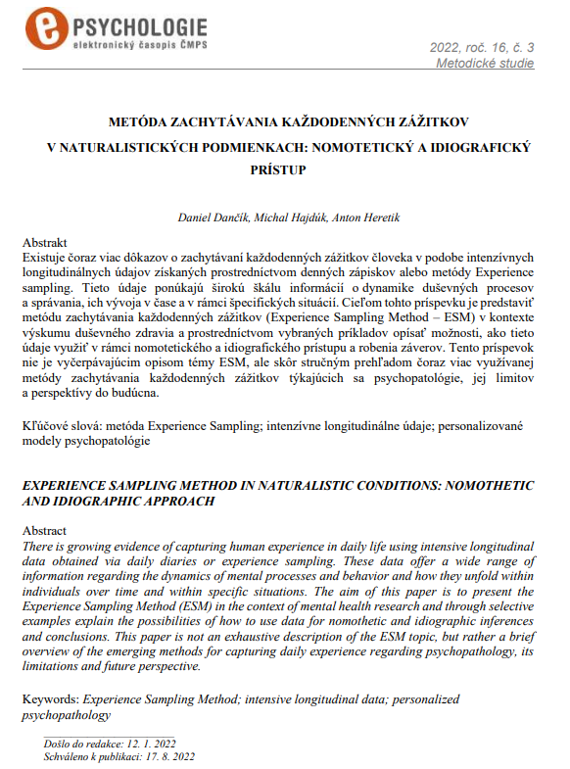
WP7 – Dissemination
ISRCTN registry: https://doi.org/10.1186/ISRCTN15109760
Website for clinicians and service users
Publications in national journals: 1
Talks at conferences: 2
Symposia: 2
Social media/ Twitter: @IMMERSE
This project has received funding from the European Union’s Horizon 2020 research and innovation Programme under grant agreement 945263 (IMMERSE)
Notes:
Dancik_etal.pdf (e-psycholog.eu)

Slide 17
WP7 – Next steps
Data collection
 | Task | Deadline
MS 18 | Data checking and cleaning for 50% of sample completed | 12/23
MS 23 | Last patient, last assessment (100% of sample completed) | 06/24
MS 20 | Data quality checking and cleaning (completed for 100% of the sample) | 08/24
 | Completion of statistical analysis | 12/24
D 7.4 | Completion of Report on status of posting results | 18.3.25
D 7.5 | Report on implementation process evaluation | 18.3.25
D 7.6 | Report on economic evaluation | 18.3.25
This project has received funding from the European Union’s Horizon 2020 research and innovation Programme under grant agreement 945263 (IMMERSE)

